Slide 1
Beyond the PUMA
Supplemental Geography in ACS Microdata from IPUMS USA
Jonathan Schroeder - IPUMS Research Scientist
Grace Cooper - IPUMS Senior Data Analyst
December 10, 2025

Slide 2
Zoom Logistics
Webinar is being recorded & will be posted
Real-time closed captions are being auto-generated
  Turn off/on by clicking “CC” button in Zoom controls
Send questions about Zoom directly to host (IPUMS)
Submit content questions with Q&A tool
Will post written Q&A document following webinar

Slide 3
IPUMS USA

Slide 4
Censuses & Surveys
Topical coverage
U.S. decennial censuses
  Household- and county-level (1790-1840)
  Full count (1850-1950)
  Samples (1960-2020)
American Community Surveys
  2000 - 2023
  Full survey responses for 1% of US population per year
  Yearly and multi-year samples
  Suppression for confidentiality
Supplemental Datasets/Resources
Geography
Group quarters
Housing characteristics
Household economic characteristics
Age
Race
Marital Status
Birthplace
Family Interrelationship
Education
Work
Income
Disability
Migration Status
Commuting
Health Insurance
Nationality
Household appliances

Slide 5
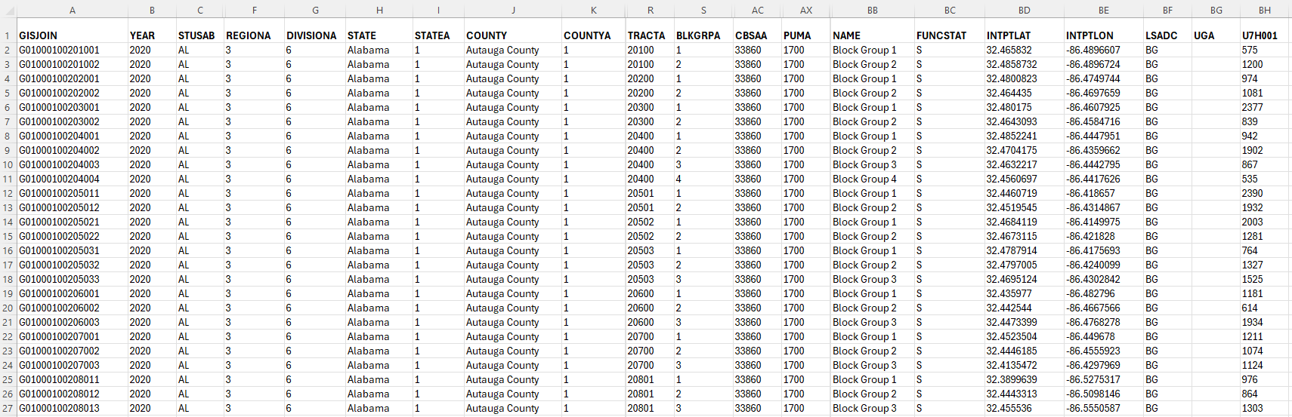
Summary Data
Unique Identifier
Block Group code
Population
Block Group

Slide 6
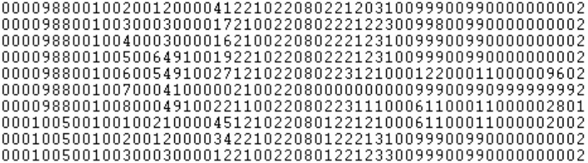
Microdata
Relation to head
Marital status
Household
Education
Occupation
Individual

Slide 7
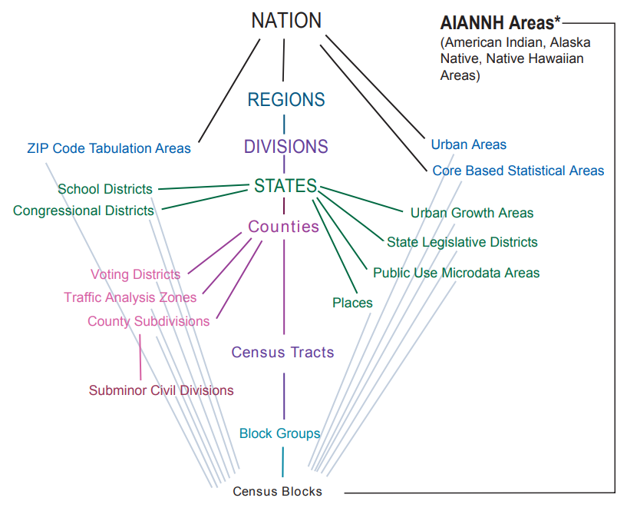
Observation units of census & survey data
Summary data: Areas
Microdata: Respondents
Households
Persons
+ Flexible classification, modeling &
cross-tabulation
- Restricted geographic detail
https://www.census.gov/geo/reference/hierarchy.html

Slide 8
GEOGRAPHY IN PUMS DATA

Slide 9
Geography in ACS microdata
Regions, states & …
Public Use Microdata Areas (PUMAs):
  At least 100,000 residents
    2010 average population: 131,000, max: 269,000
    2020 average population: 135,000, max: 270,930
  In use since 1970*
    *Called “county groups” in 1970 & 1980
  IPUMS has also defined 1960 PUMAs
Only modern samples face geographic confidentiality limits—Full Count Files (1950 and earlier) provide far more detailed geography.

Slide 10
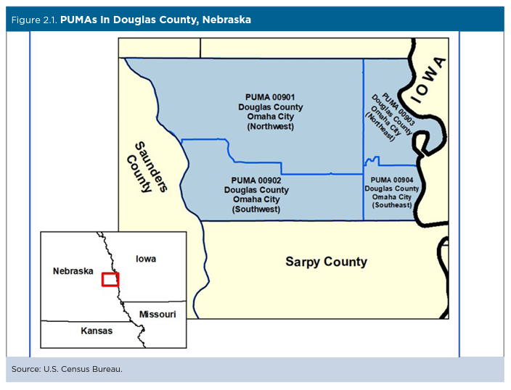
Public Use Microdata Area (PUMA)
Lowest level of geography identified in recent decennial census and ACS
Must contain a population of at least 100,000 people
State-dependent (combine with state identifier for unique ID)

Slide 11
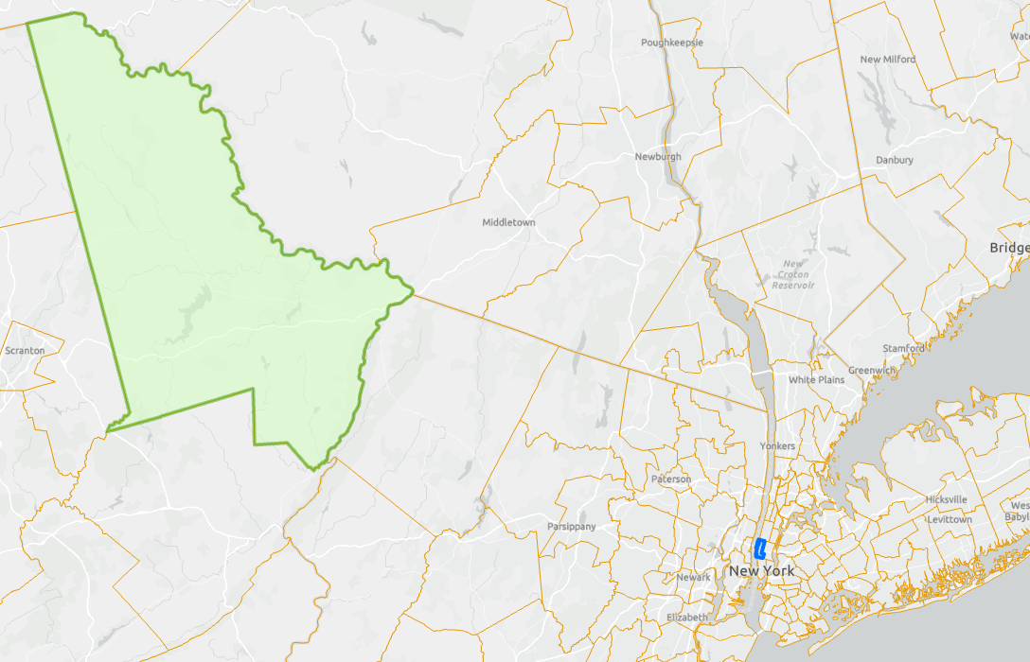
PUMA problems
Limited spatial precision due to variable extents
Large PUMAs tell you less about the immediate community of an individual

Slide 12
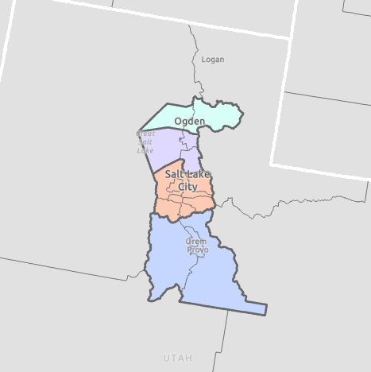
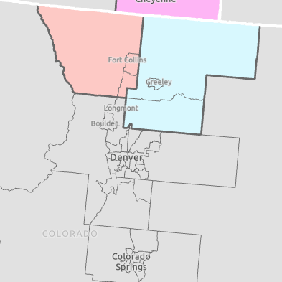
PUMA problems
Limited spatial precision due to variable extents
Spatially inconsistent with other geographies
Identifiable counties based on 2020 PUMAs
Salt Lake City
Denver
Core counties are not identifiable
PUMA correspondence with counties is better in some metro areas than in others

Slide 13
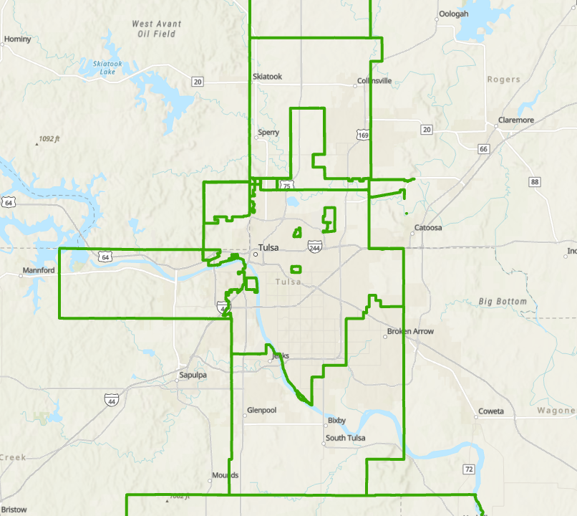
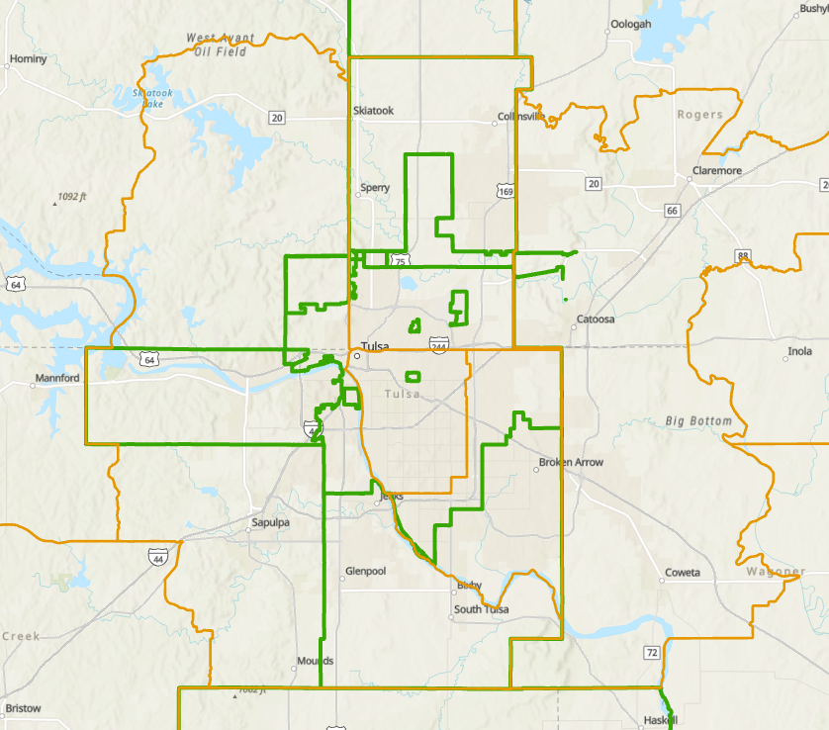
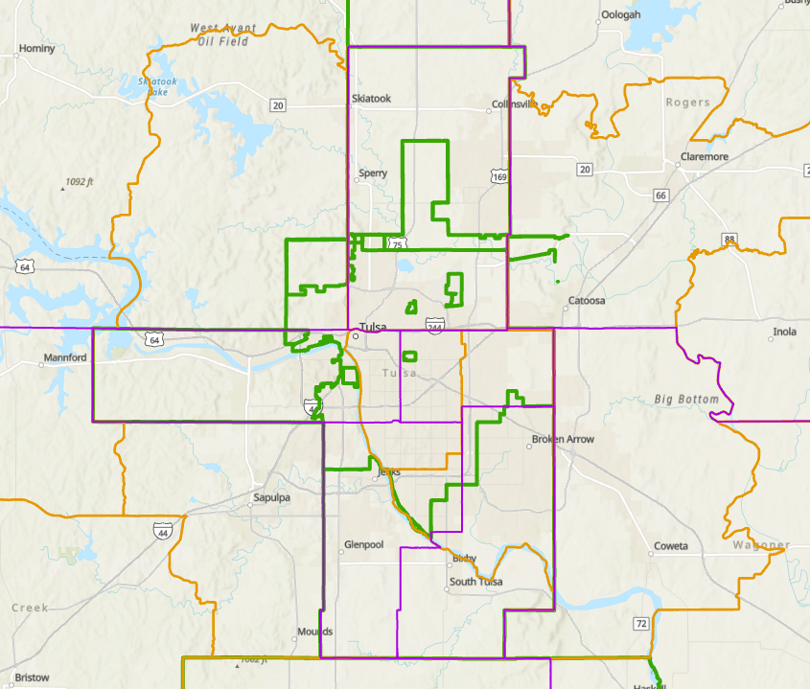
PUMA problems
Limited spatial precision due to variable extents
Spatially inconsistent with other geographies
Temporally inconsistent
2000
2010
2020
Changing PUMA delineations reflect growing metro areas

Slide 14
PUMA vintages
Census Bureau produces new PUMA definitions every 10 years, based on the decennial census
2000 PUMAs
2010 PUMAs
2020 PUMAs
2005 - 2011 ACS/PRCS
2012 - 2021 ACS/PRCS
2022 - 2031 ACS/PRCS
2000
2005
2010
2015
2020
2025
2030
2035
Year
2010-2015 ACS 5-yr sample
2010-2011 – 2000 PUMAs
2012-2015 – 2010 PUMAs

Slide 15
SUPPLEMENTAL Geographic VARIABLES

Slide 16
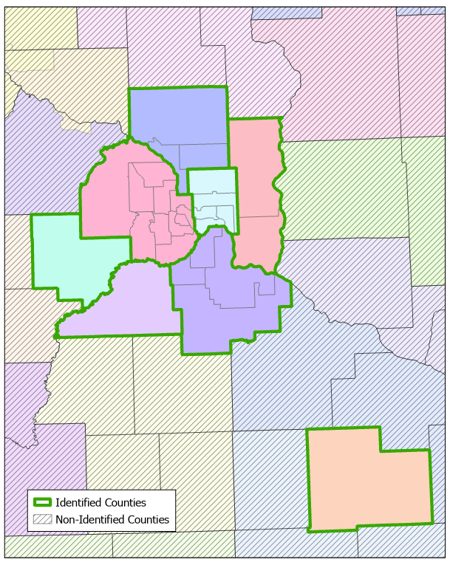
Counties
Two Variables
Variable | Samples | Code Scheme
COUNTYICP | All Samples | ICPSR
COUNTYFIP | ≥ 1950 | FIPS
Minneapolis
St. Paul
Identify only counties that match PUMA(s)
PUMA Vintage | Samples | Counties identified | Percent of US population
2000 | ≤ 2011 ACS | 376 | 59%
2010 | 2012-2021 ACS | 429 | 64%
2020 | ≥ 2022 ACS | 448 | 62%
Rochester

Slide 17
Cities
A.k.a. census “places”
Protocol:
  Identify best-matching PUMAs (city in which the majority of the PUMA’s population lives)
  Identify city only if match with best-matching PUMAs is “good”
    Sum of mismatch error < 10%
  CITYERR variable: classification of the sum of errors
    1 = No coverage error (perfect match)
    2 = 0.1 – 0.9% error
    3 = 1.0 – 1.9% error
    4 = 2.0 – 4.9% error
    5 = 5.0 – 9.9% error

Slide 18
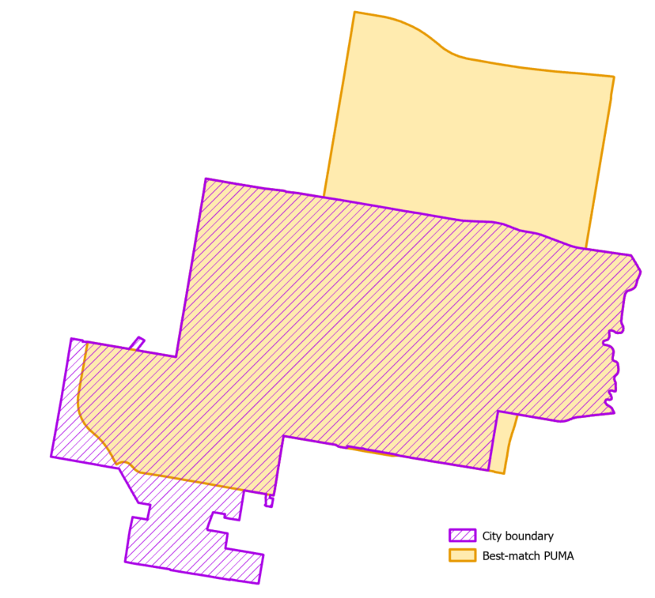
Measuring mismatch
Sum of errors = omission + commission
Omission Error: Percent of city population not in PUMA
Commission Error: Percent of PUMA’s population not in city
West Valley City, UT
Intersecting PUMAs | 3
Best-matching PUMAs | 1
Omission error | 3.38
Commission error | 0.51
Sum of errors | 3.89
CITYERR class | 4
COMMISSION ERROR
OMISSION ERROR

Slide 19
Metropolitan areas
MET2023: metro area of residence based on 2023 MSAs
  Protocol: Identified if mismatch error is < 15%
  Samples: 2012 ACS – current
MET2013: metro area of residence based on 2013 MSAs
  Protocol: Identified if mismatch error is < 15%
  Samples: 2000 ACS – current
METAREA: metro area (pre-2013 delineations)
  Samples: 1850 – 2011 (not being updated)
  Protocol: Identified only if a PUMA nests within an MSA

Slide 20
Metro areas identified by MET2013
PUMA Vintage | Samples | MSAs identified | 100 largest MSAs | Non-identifiable MSAs (100 largest)
2000 | ≤ 2011 ACS | 266 | 96 | Madison, WI; Tulsa, OK; Columbia, SC; Des Moines, IA
2010 | 2012-2021 ACS | 260 | 98 | Madison, WI; Tulsa, OK
2020 | ≥ 2022 ACS | 270 | 98 | Madison, WI; Durham-Chapel Hill, NC
IPUMS provides crosswalks and match summaries for variables with identification based on mismatch errors:
MET2013
MET2023
CITY

Slide 21
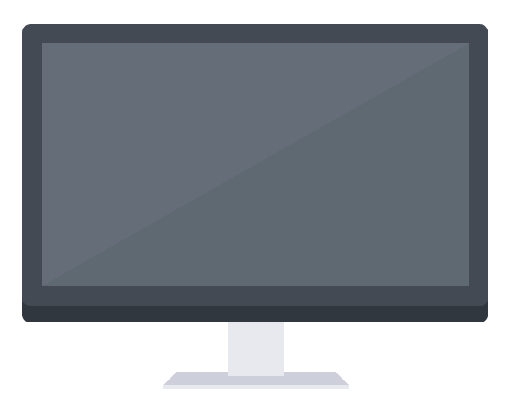
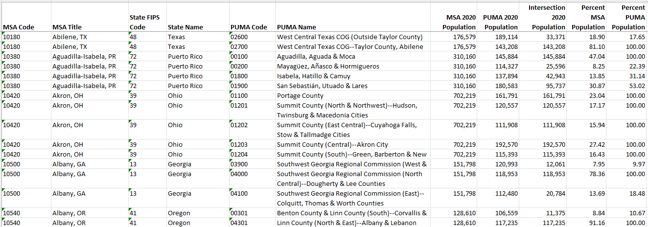
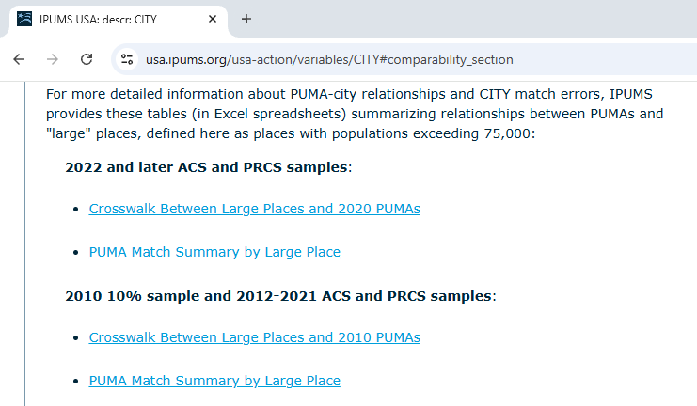
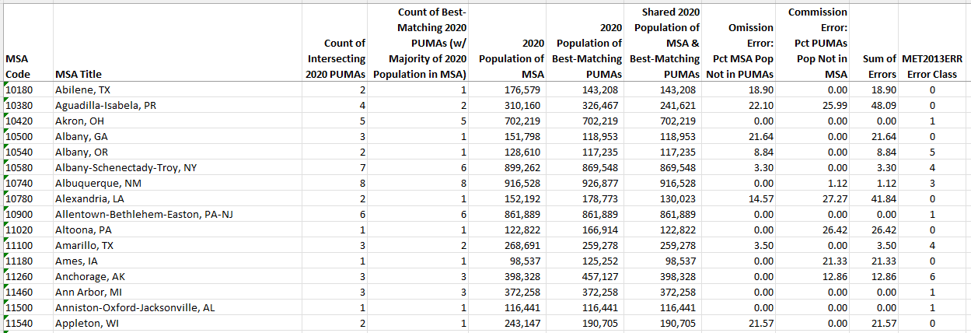
Additional Resources
Crosswalk: Intersections between all PUMAs and MSAs and their shared populations
Match Summary: Number of matching PUMAs per MSA and associated errors
Notes:
For more detailed information about PUMA-metro area or PUMA-city relationships and match errors (omission/commission), IPUMS provides these tables

Slide 22
CREATION OF MET2023

Slide 23

MET2023
Objective: identify the association between 2023 MSAs and PUMAs
MSAs
(from CBSAs)
$$≠$$
PUMAs
sub-PUMA geographic units

Slide 24
MET2023
Objective: identify the association between 2023 MSAs and 2020 PUMAs
2023 MSAs
MET2023 (2022 – 2031 ACS samples)
2020 PUMAs
Census Bureau
CBSA delineation file
Special handling for Connecticut:
2020 ‘counties’ changed to ‘planning regions’ in 2022
2020 Counties
NHGIS table files
include PUMA ID
Merge 2022 CT Planning Regions with all other 2020 Counties
Extract from Block IDs
2022 CT Counties
(Planning Regions)
2020 CT Block Groups
NHGIS table file
(2020 populations)
Census Bureau composition file
2020 Block Groups to 2022 Counties
Extract from Block IDs
2020 Blocks

Slide 25
MET2023
Objective: identify the association between 2023 MSAs and 2010 PUMAs
2023 MSAs
MET2023 (2012 – 2021 ACS samples)
2010 PUMAs
Census Bureau
CBSA delineation file
Census Bureau composition file
2010 Tracts to 2010 PUMAs
Special handling for Connecticut:
2020 ‘counties’ changed to ‘planning regions’ in 2022
2020 Counties
2010 Tracts
Merge 2022 CT Planning Regions with all other 2020 Counties
Extract from Block IDs
NHGIS Crosswalk 2020 Blocks to 2010 Tracts
2022 CT Counties
(Planning Regions)
2020 CT Block Groups
NHGIS table file
(2020 populations)
Census Bureau composition file
2020 Block Groups to 2022 Counties
Extract from Block IDs
2020 Blocks

Slide 26
IPUMS USA geographic resources
Supplementary variables, based on PUMAs…
  Counties, cities, metro areas
  Urban/rural indicators
  “ConsPUMAs”: Sets of PUMAs consistent across time
  Migration & place-of-work variables
Other resources:
GIS files, composition files, crosswalks, web maps

Slide 27
URBAN/RURAL INDICATORS

Slide 28
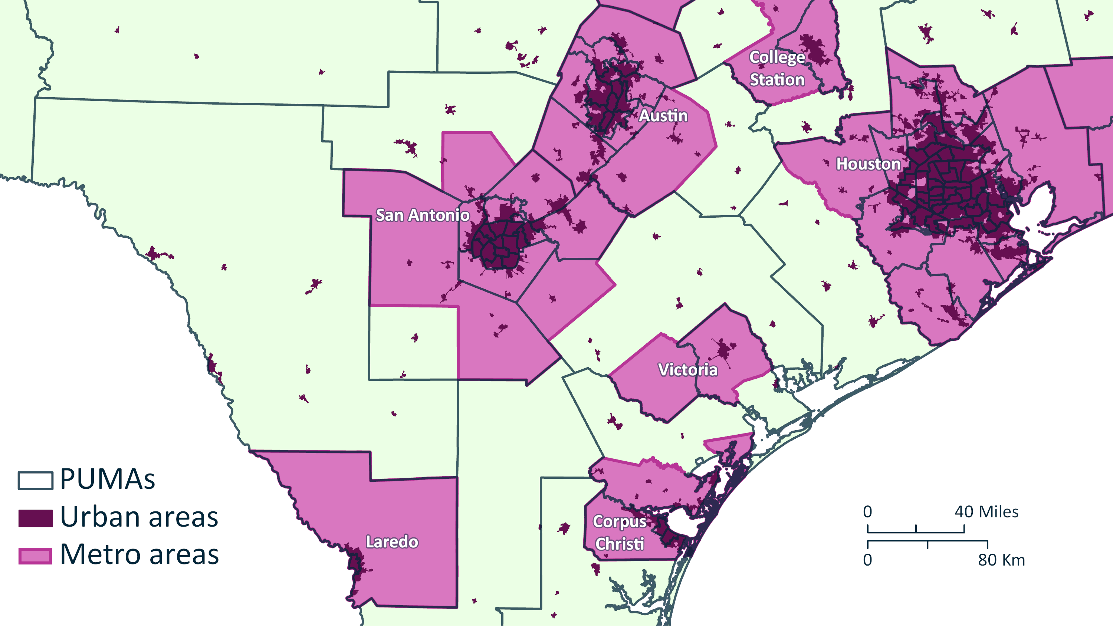

Slide 29
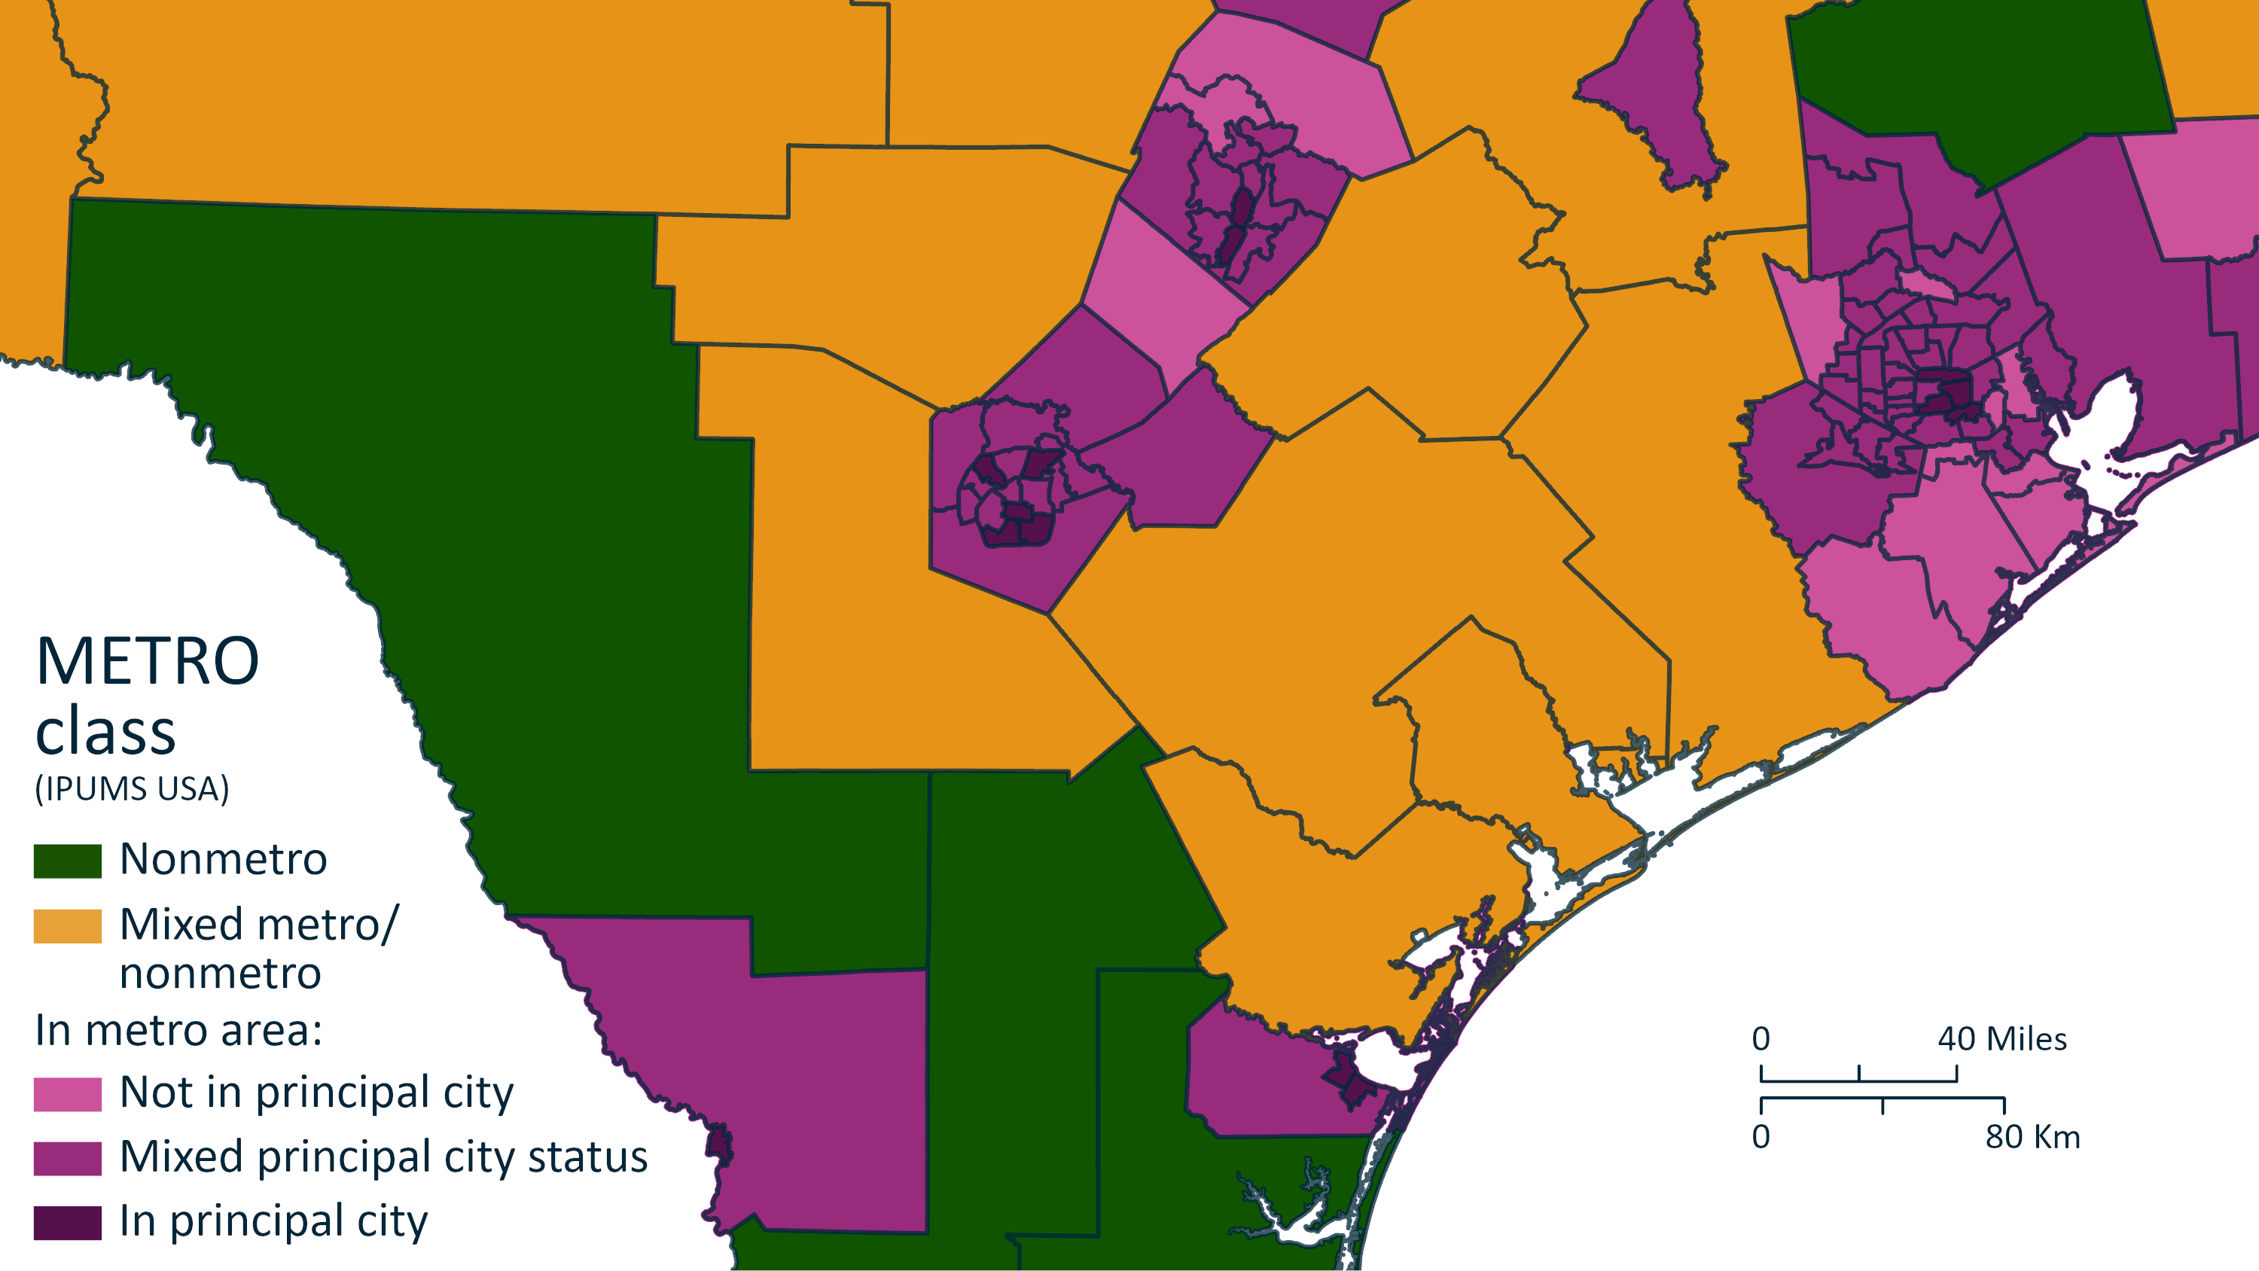

Slide 31
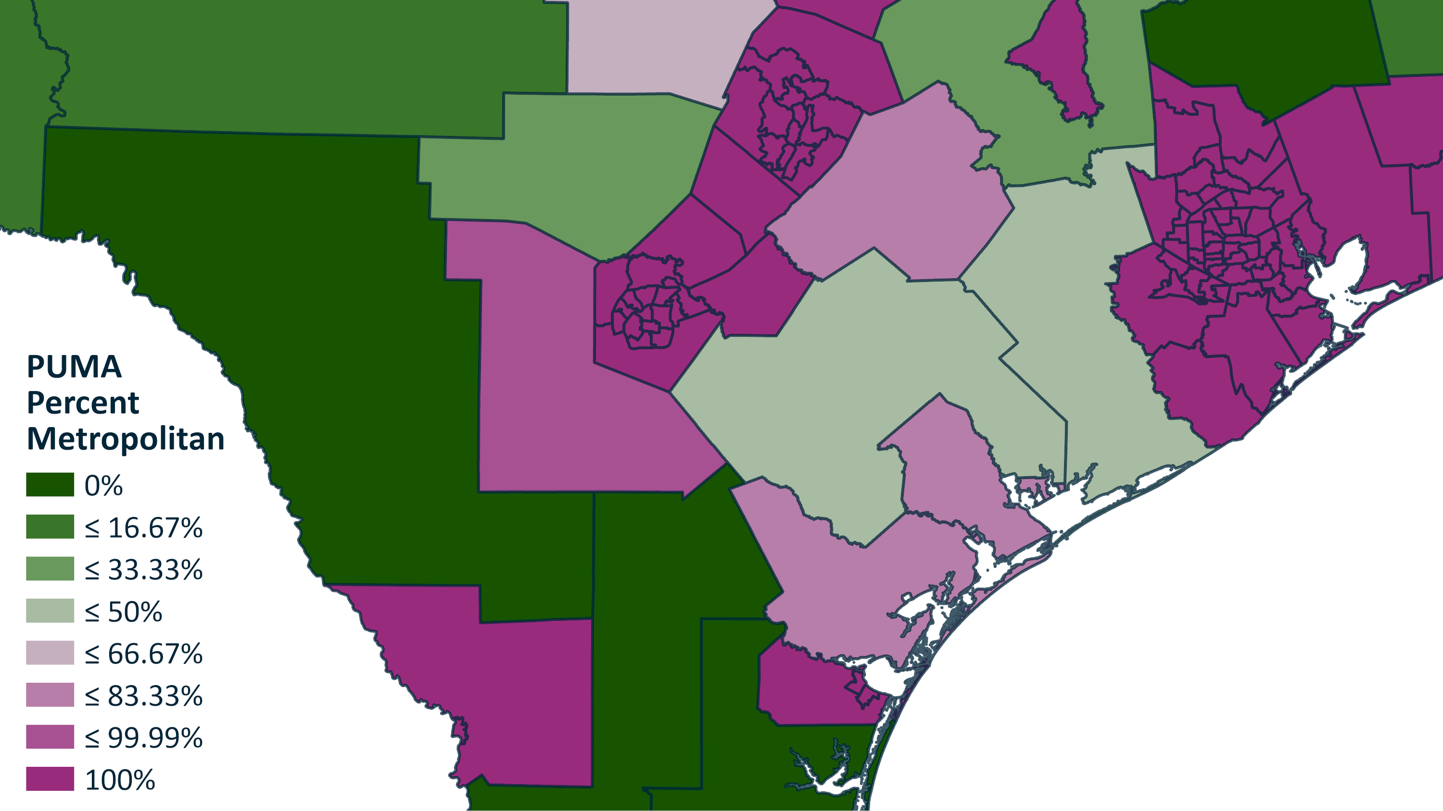
PCTMETRO

Slide 32
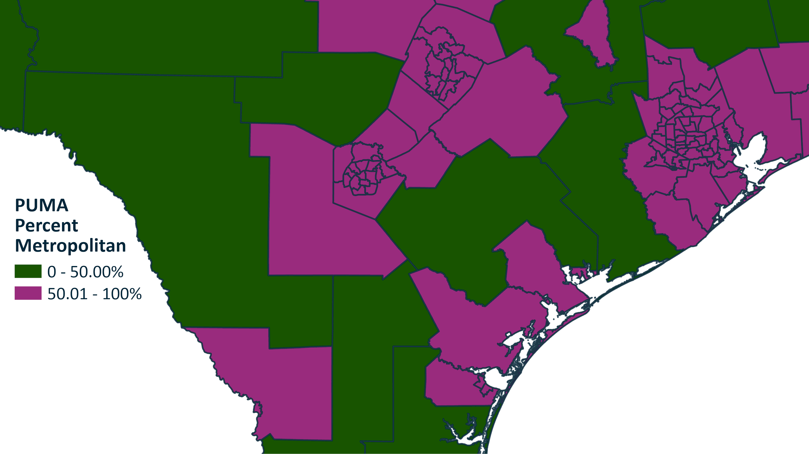
PCTMETRO

Slide 34
Are poverty rates higher in rural or urban areas?

Slide 35
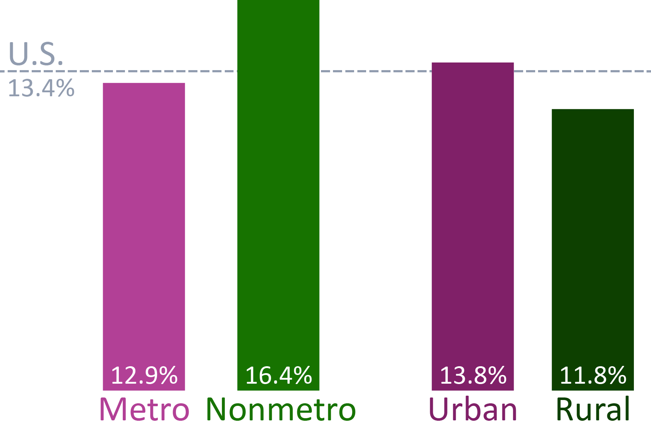
Poverty rates
2017 ACS Summary Data

Slide 36
Poverty rates
2017 ACS Summary Data

Slide 38
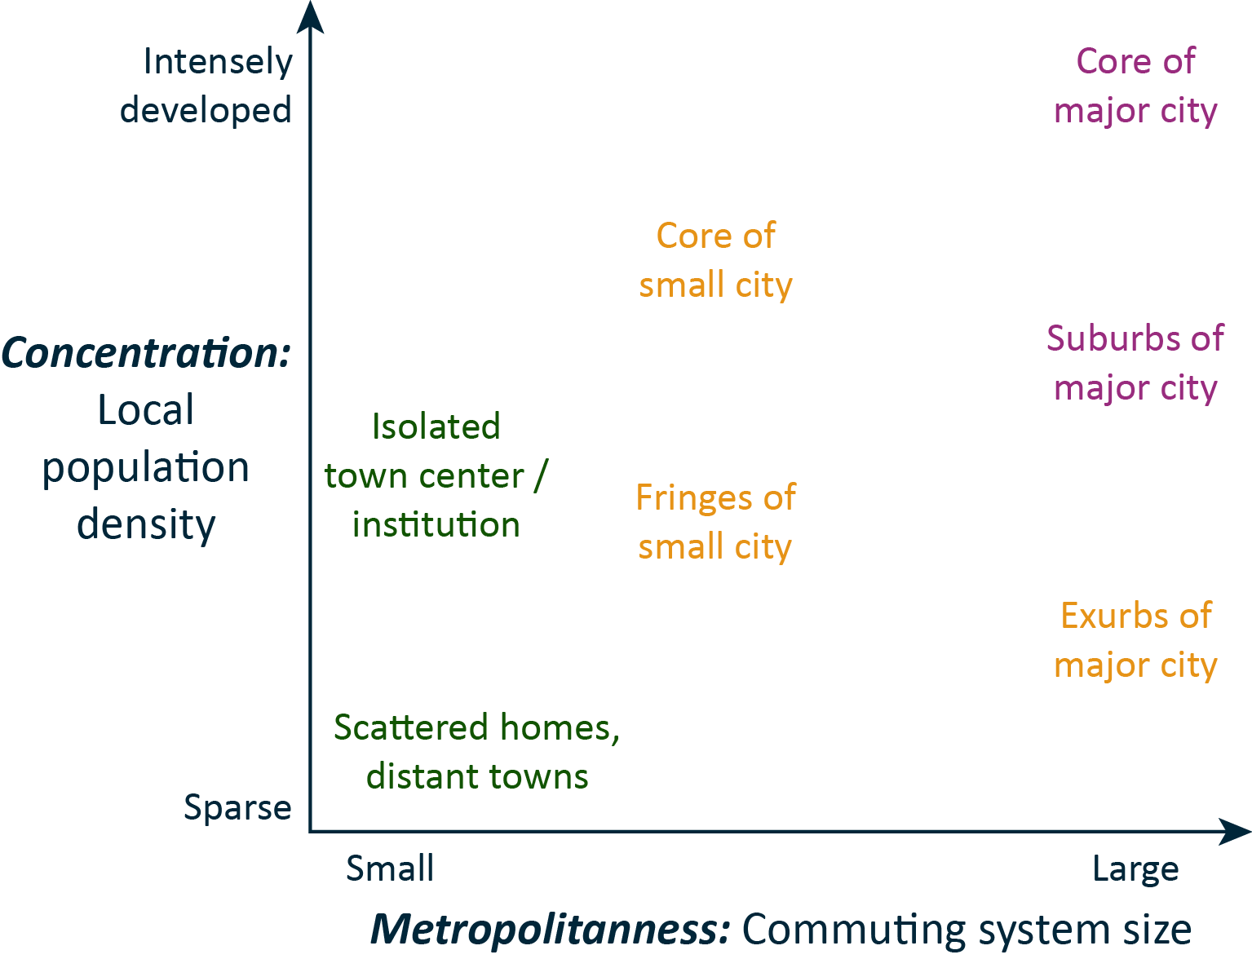
Conceptual model:
Two dimensions
Coombes & Raybould (2001)
Public policy and population distribution: developing appropriate indicators of settlement patterns. Environment and Planning C: Government and Policy, 19(2), 223-248.
Schroeder & Pacas (2021)
Across the rural-urban universe: Two continuous indices of urbanization for US census microdata. Spatial Demography, 9, 131–154. https://doi.org/10.1007/s40980-021-00081-y

Slide 40
Size: Population of commuting system

Slide 41
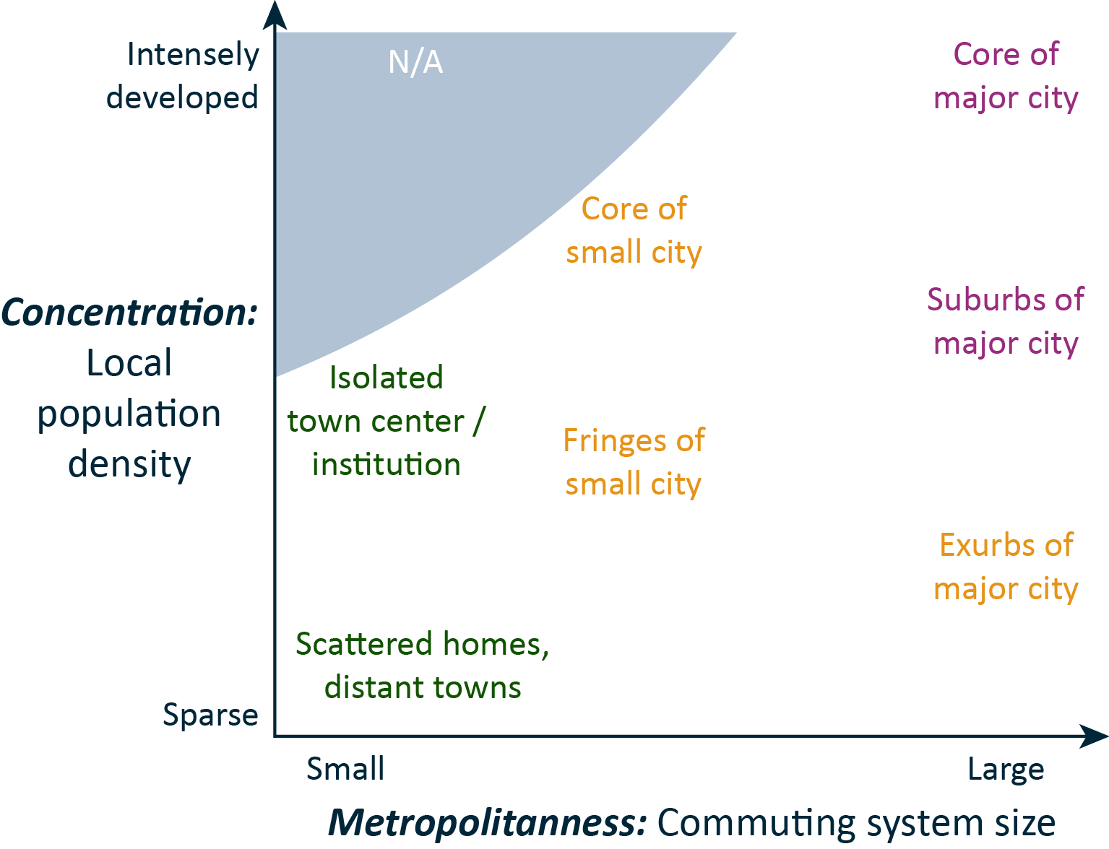
Size: Population of commuting system

Slide 42
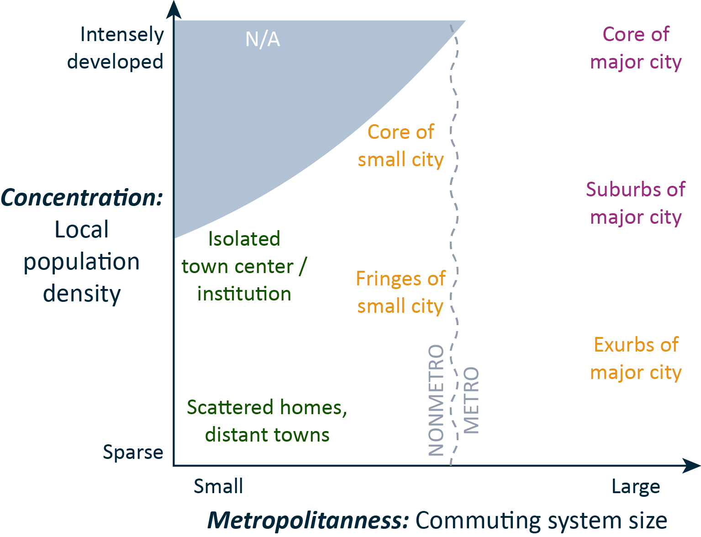
Size: Population of commuting system

Slide 43
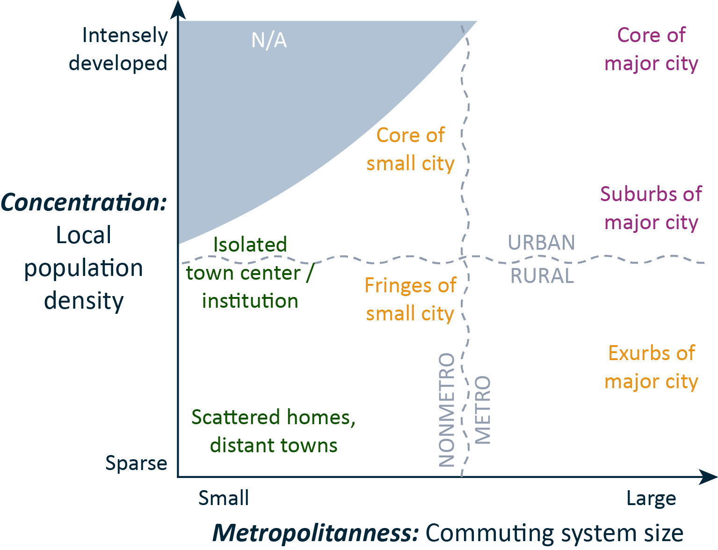
Size: Population of commuting system

Slide 44
Index of Concentration…

Slide 45
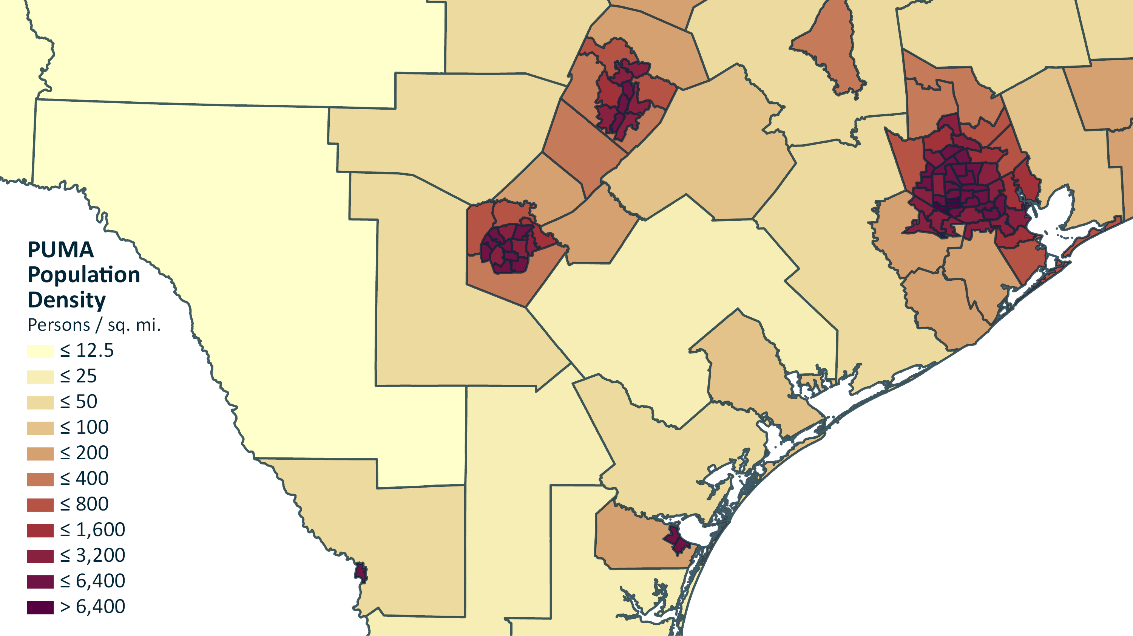

Slide 46
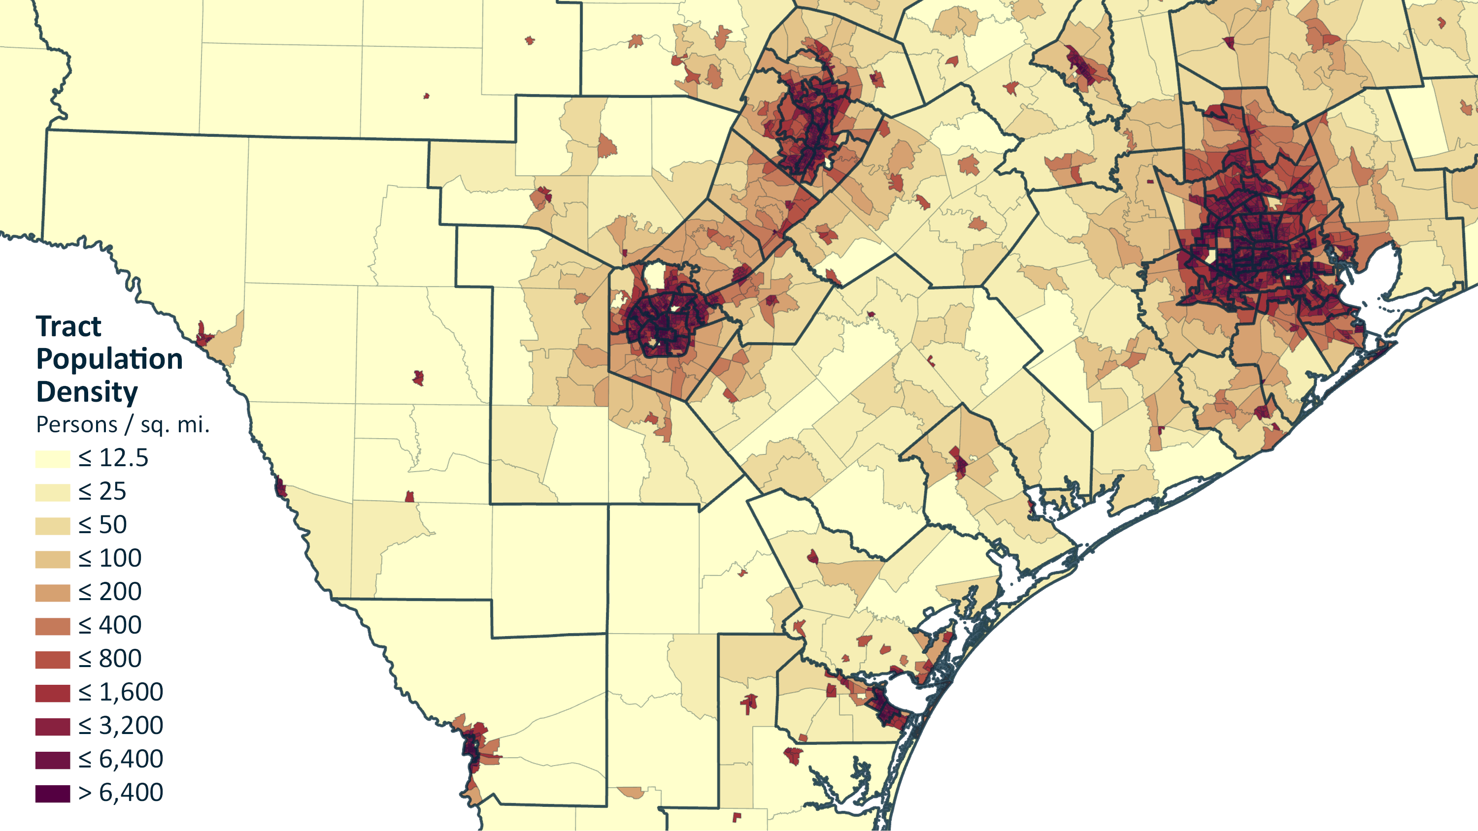

Slide 47
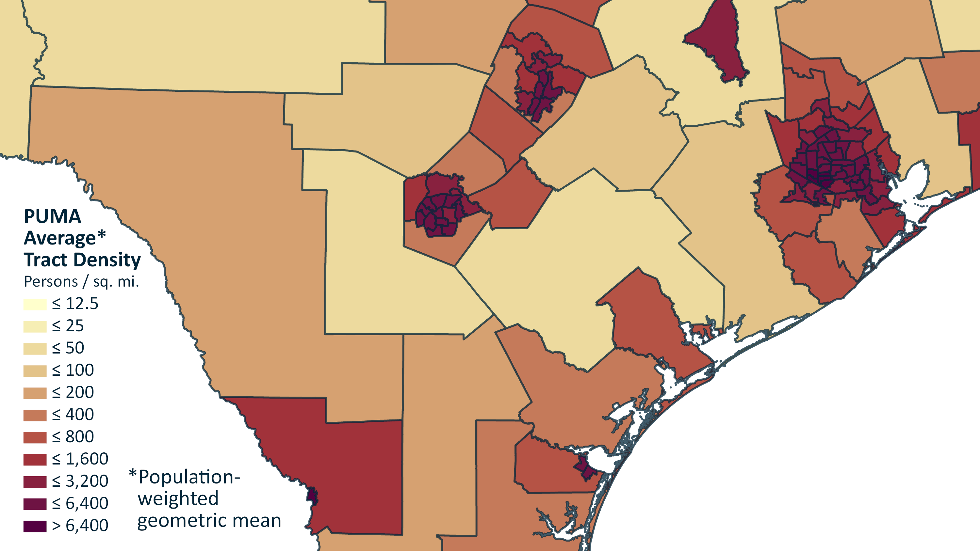
(Craig 1984)

Slide 48
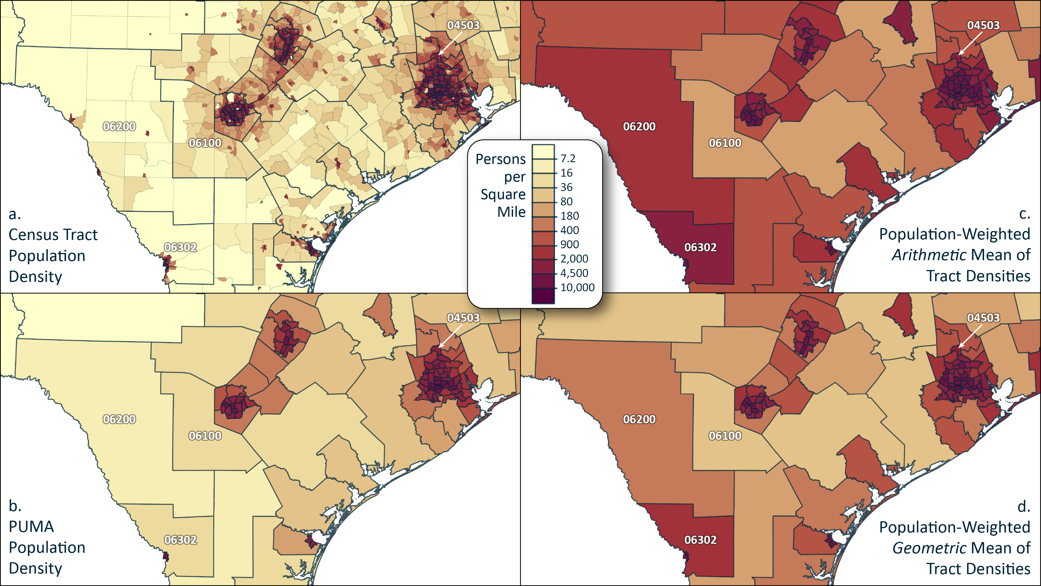

Slide 49
Index of SIZE…

Slide 50
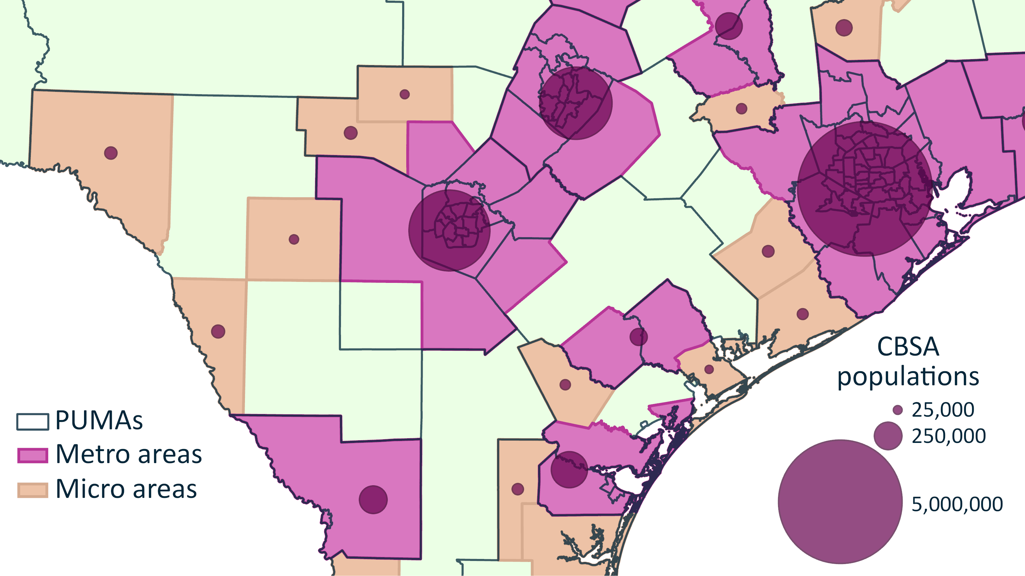

Slide 51
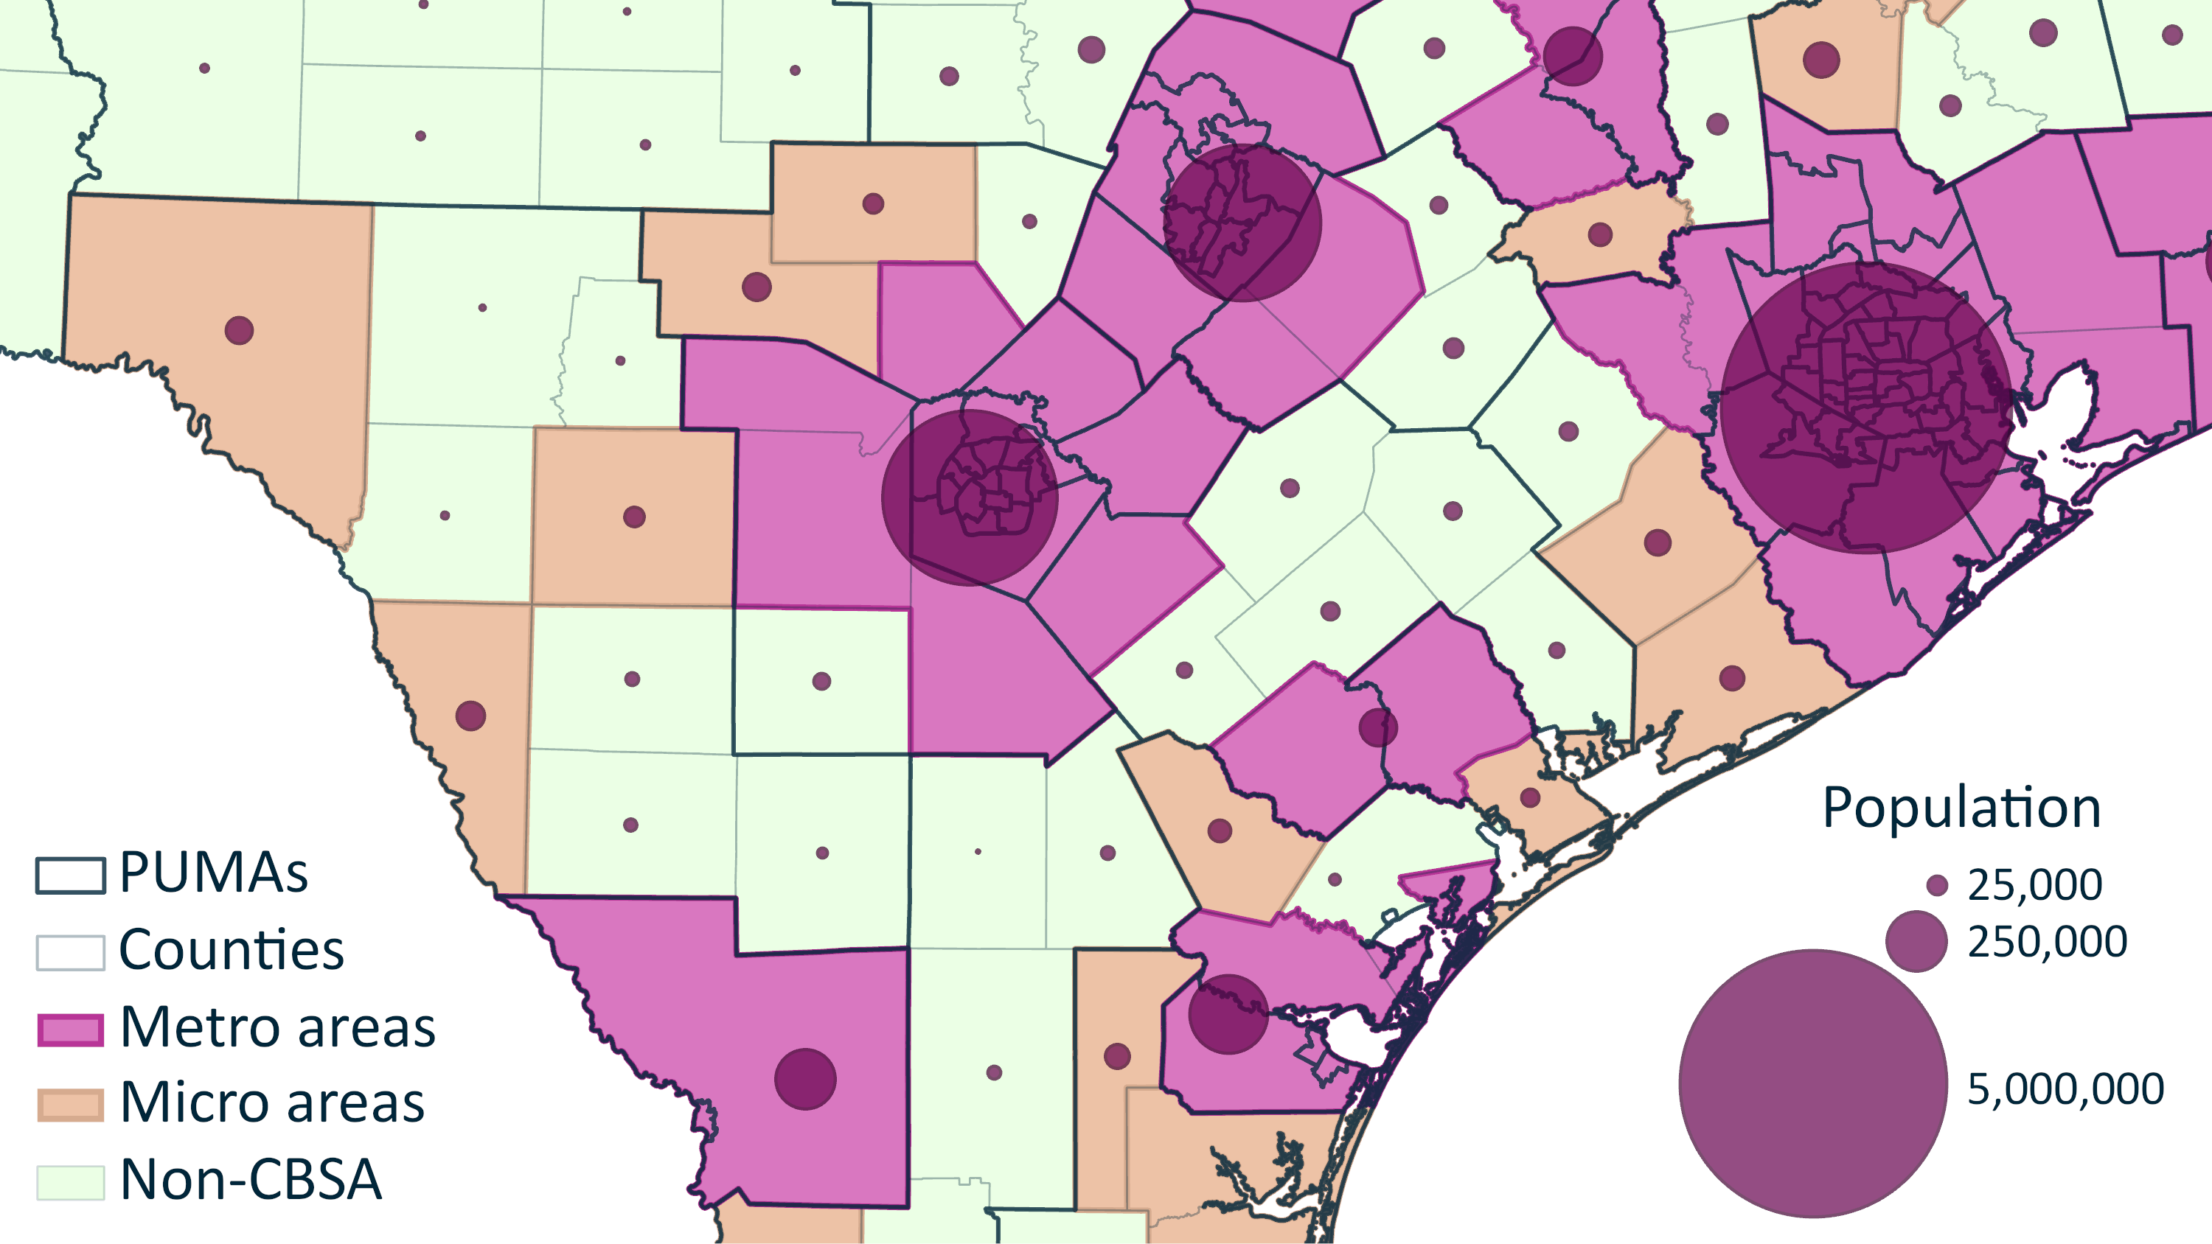
50,000
500,000
5,000,000

Slide 52
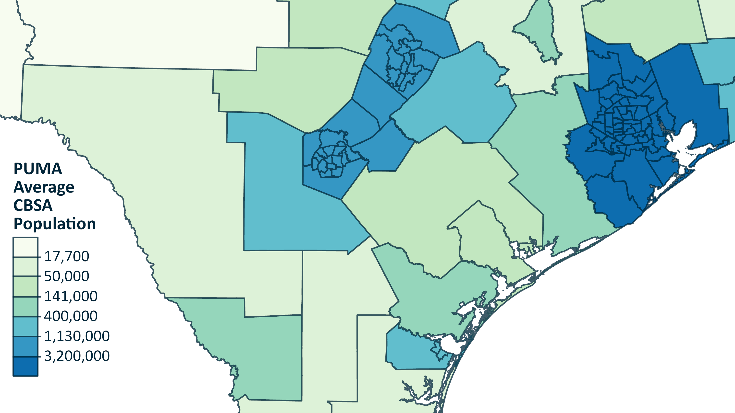
*
*Population-weighted geometric mean

Slide 53
Size: Population of commuting system

Slide 54
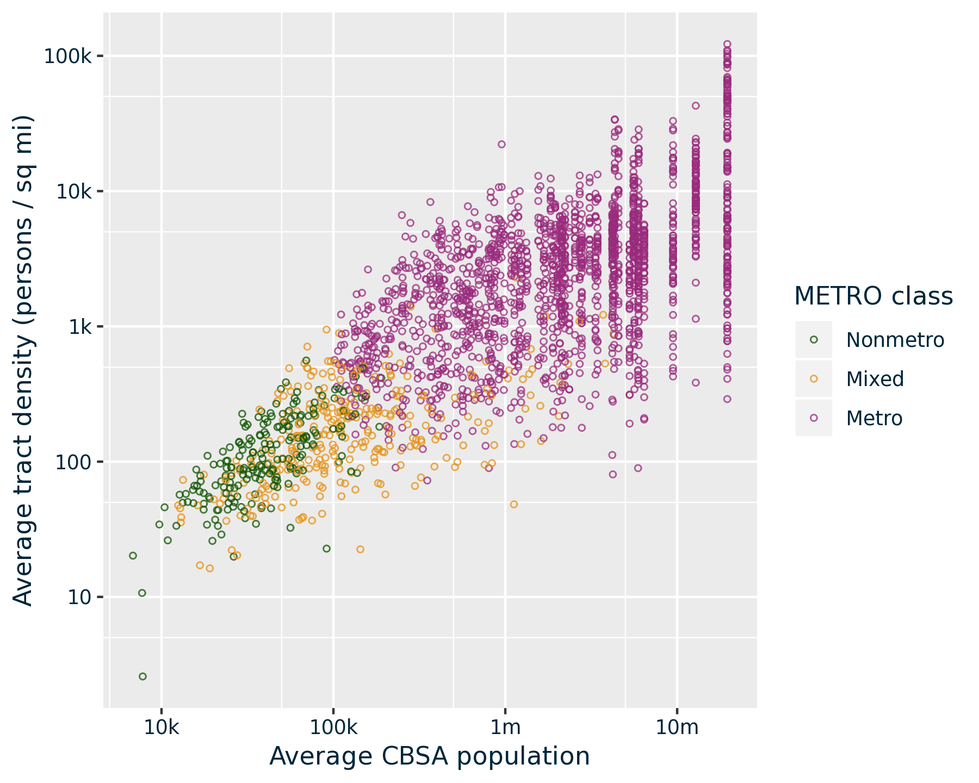
DENSITY
PUMAs
By 2 dimensions of settlement patterns
METPOP10

Slide 55
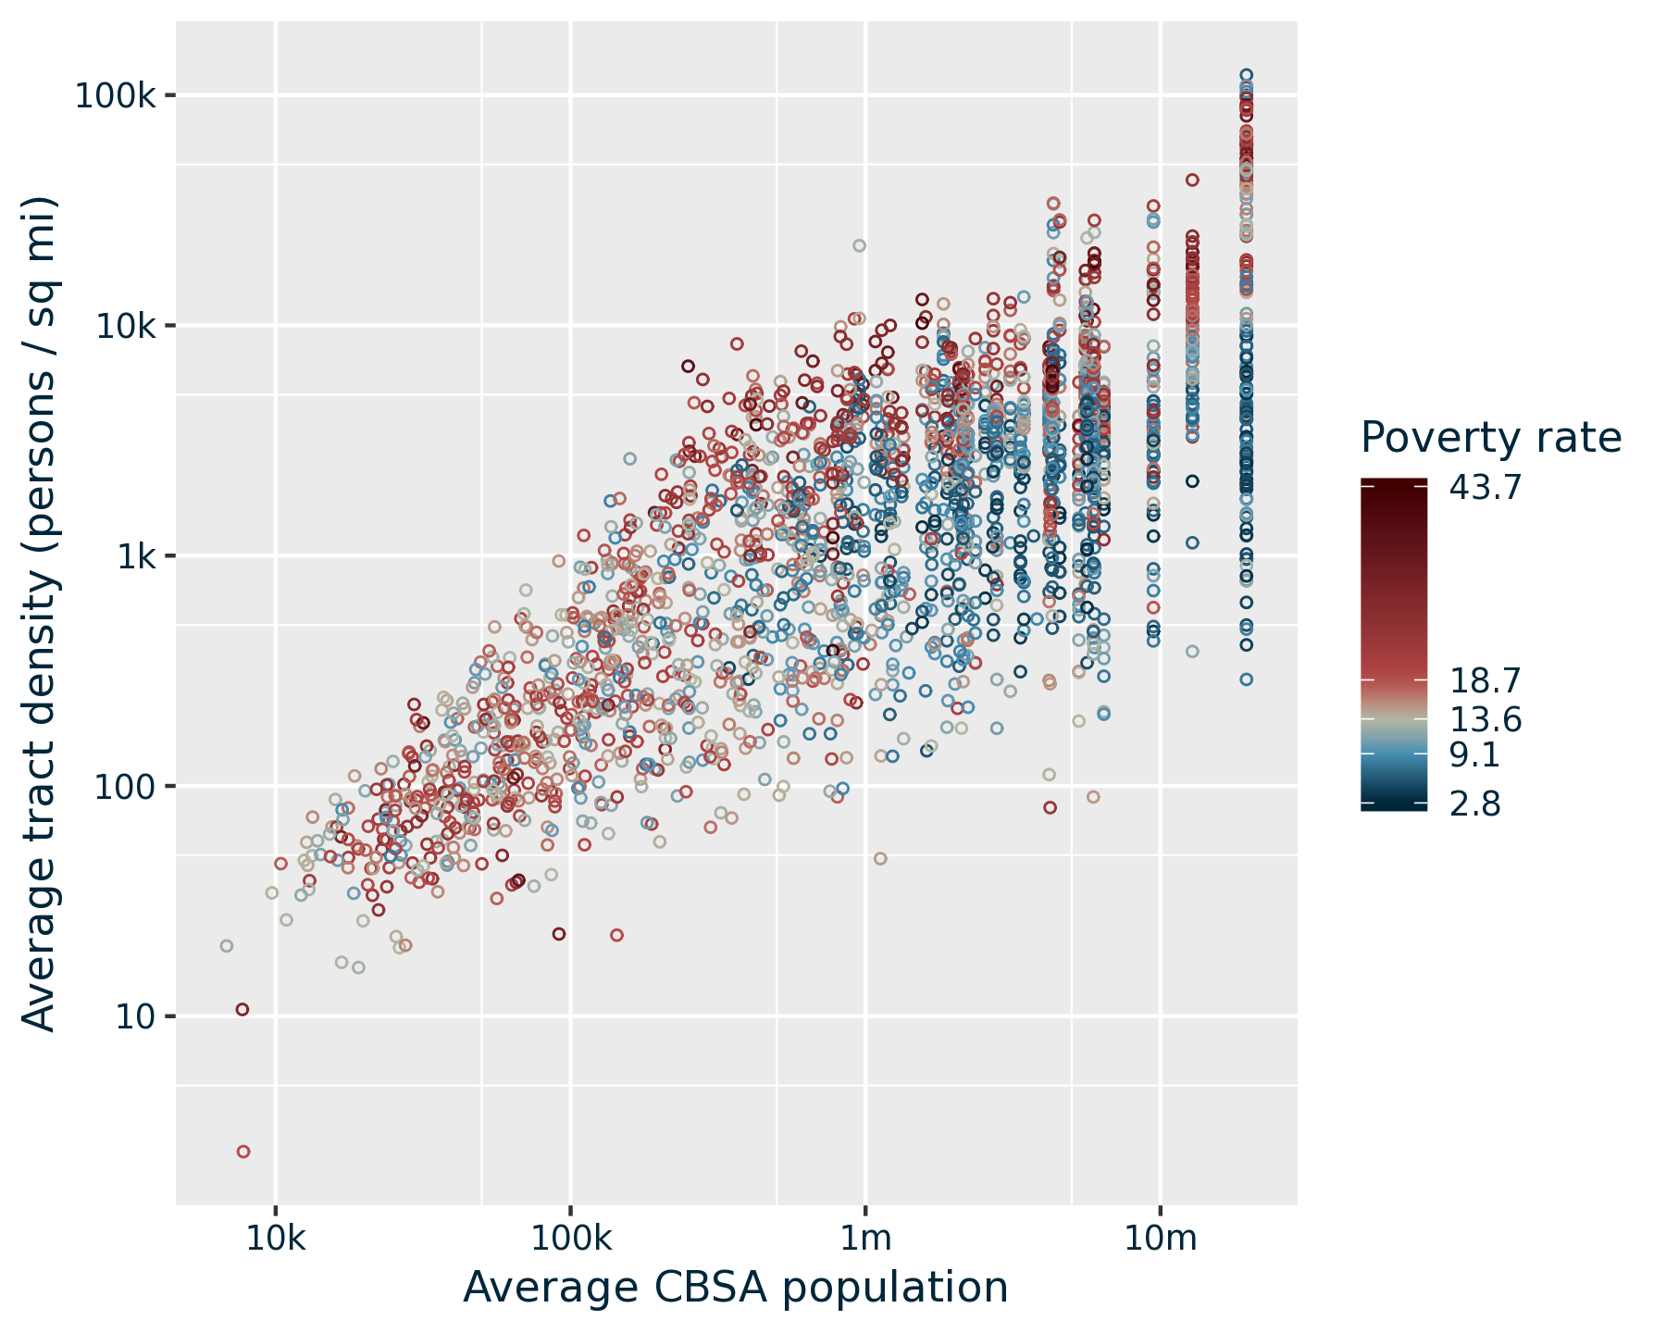
DENSITY
(2017)
Quartiles
≤
METPOP10

Slide 56
ConsPUMAs

Slide 57
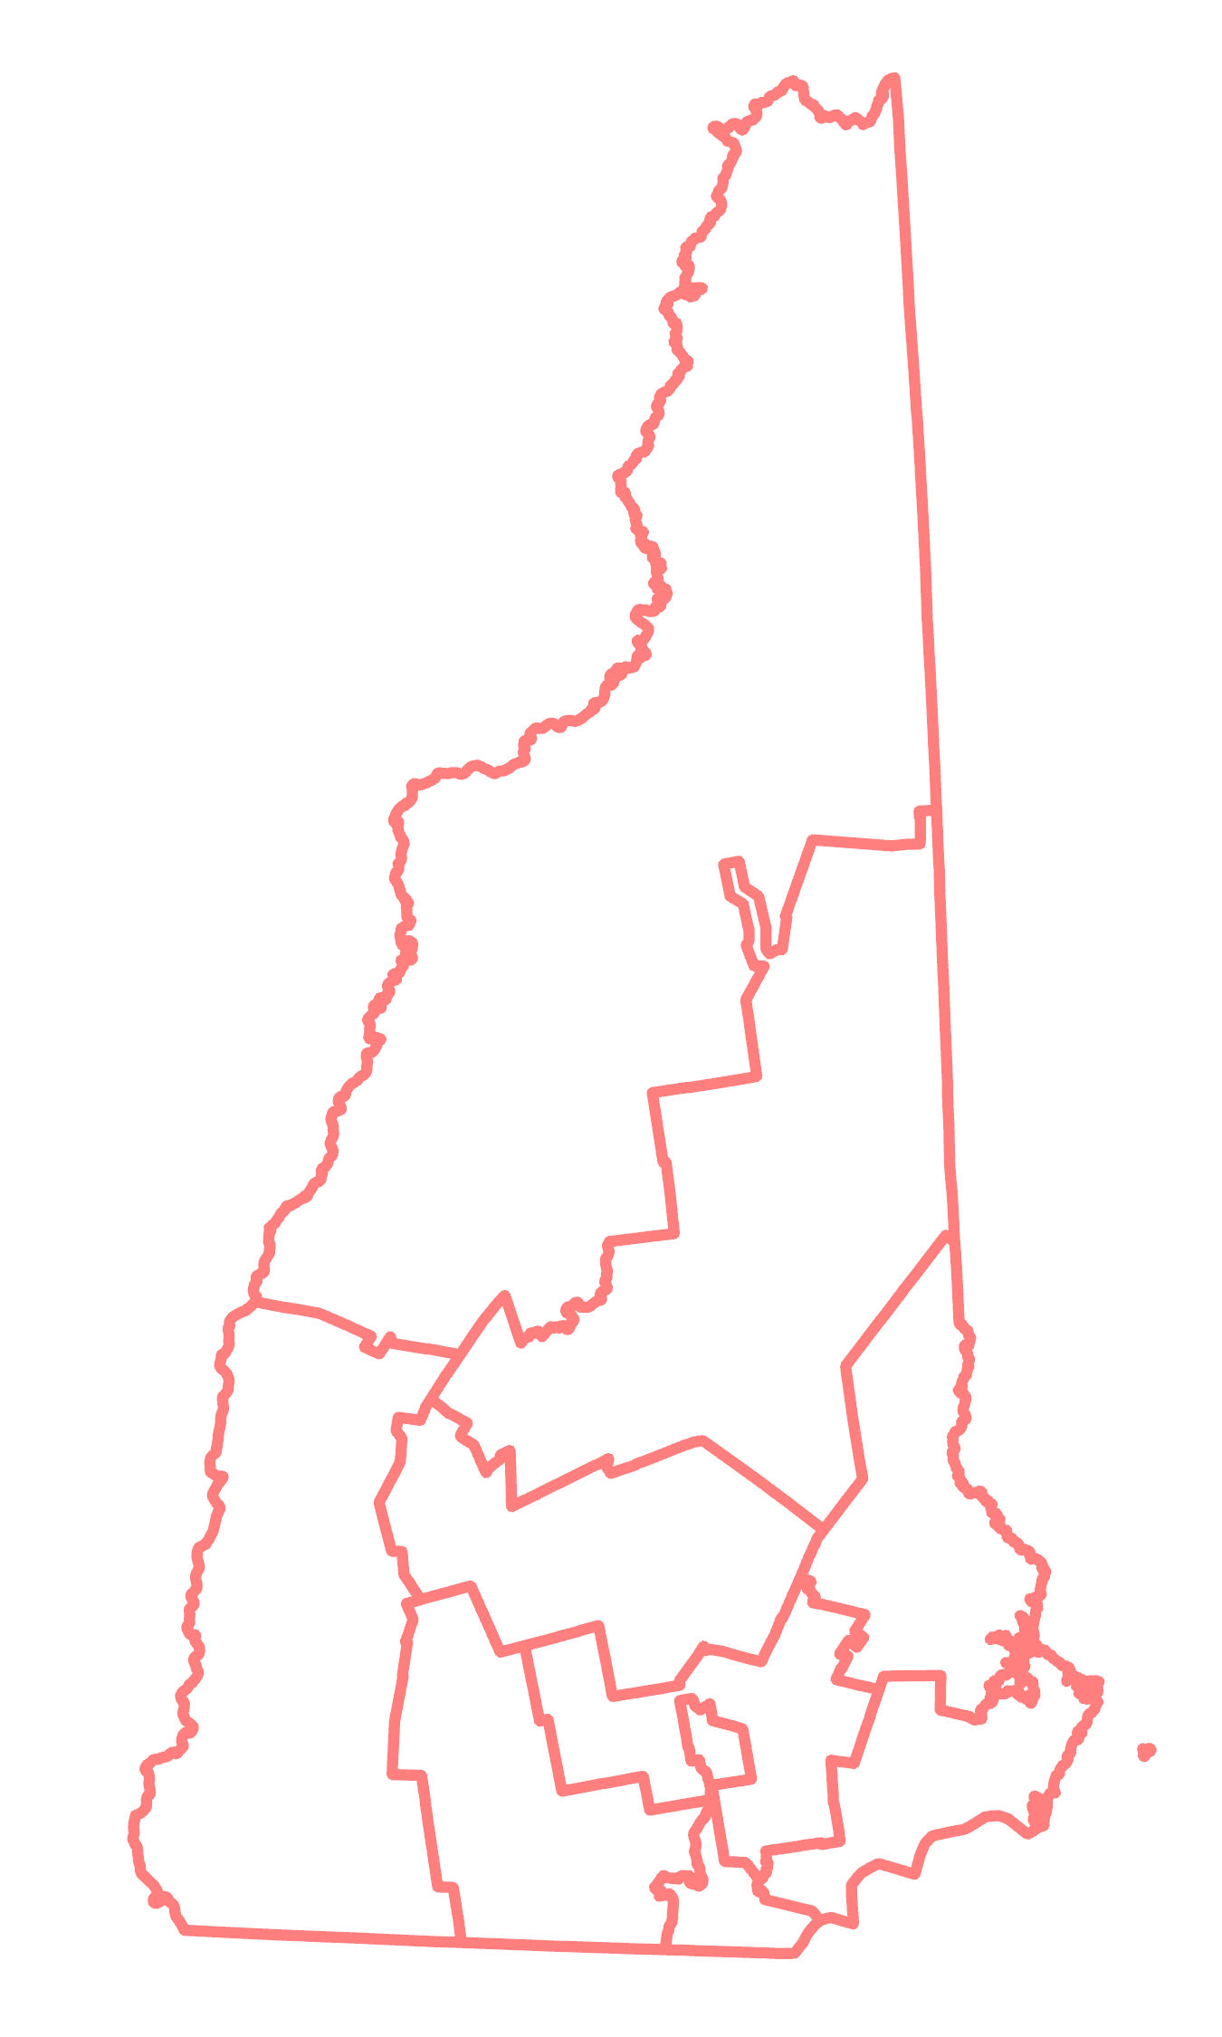
2010 PUMAs: 10
New Hampshire

Slide 58
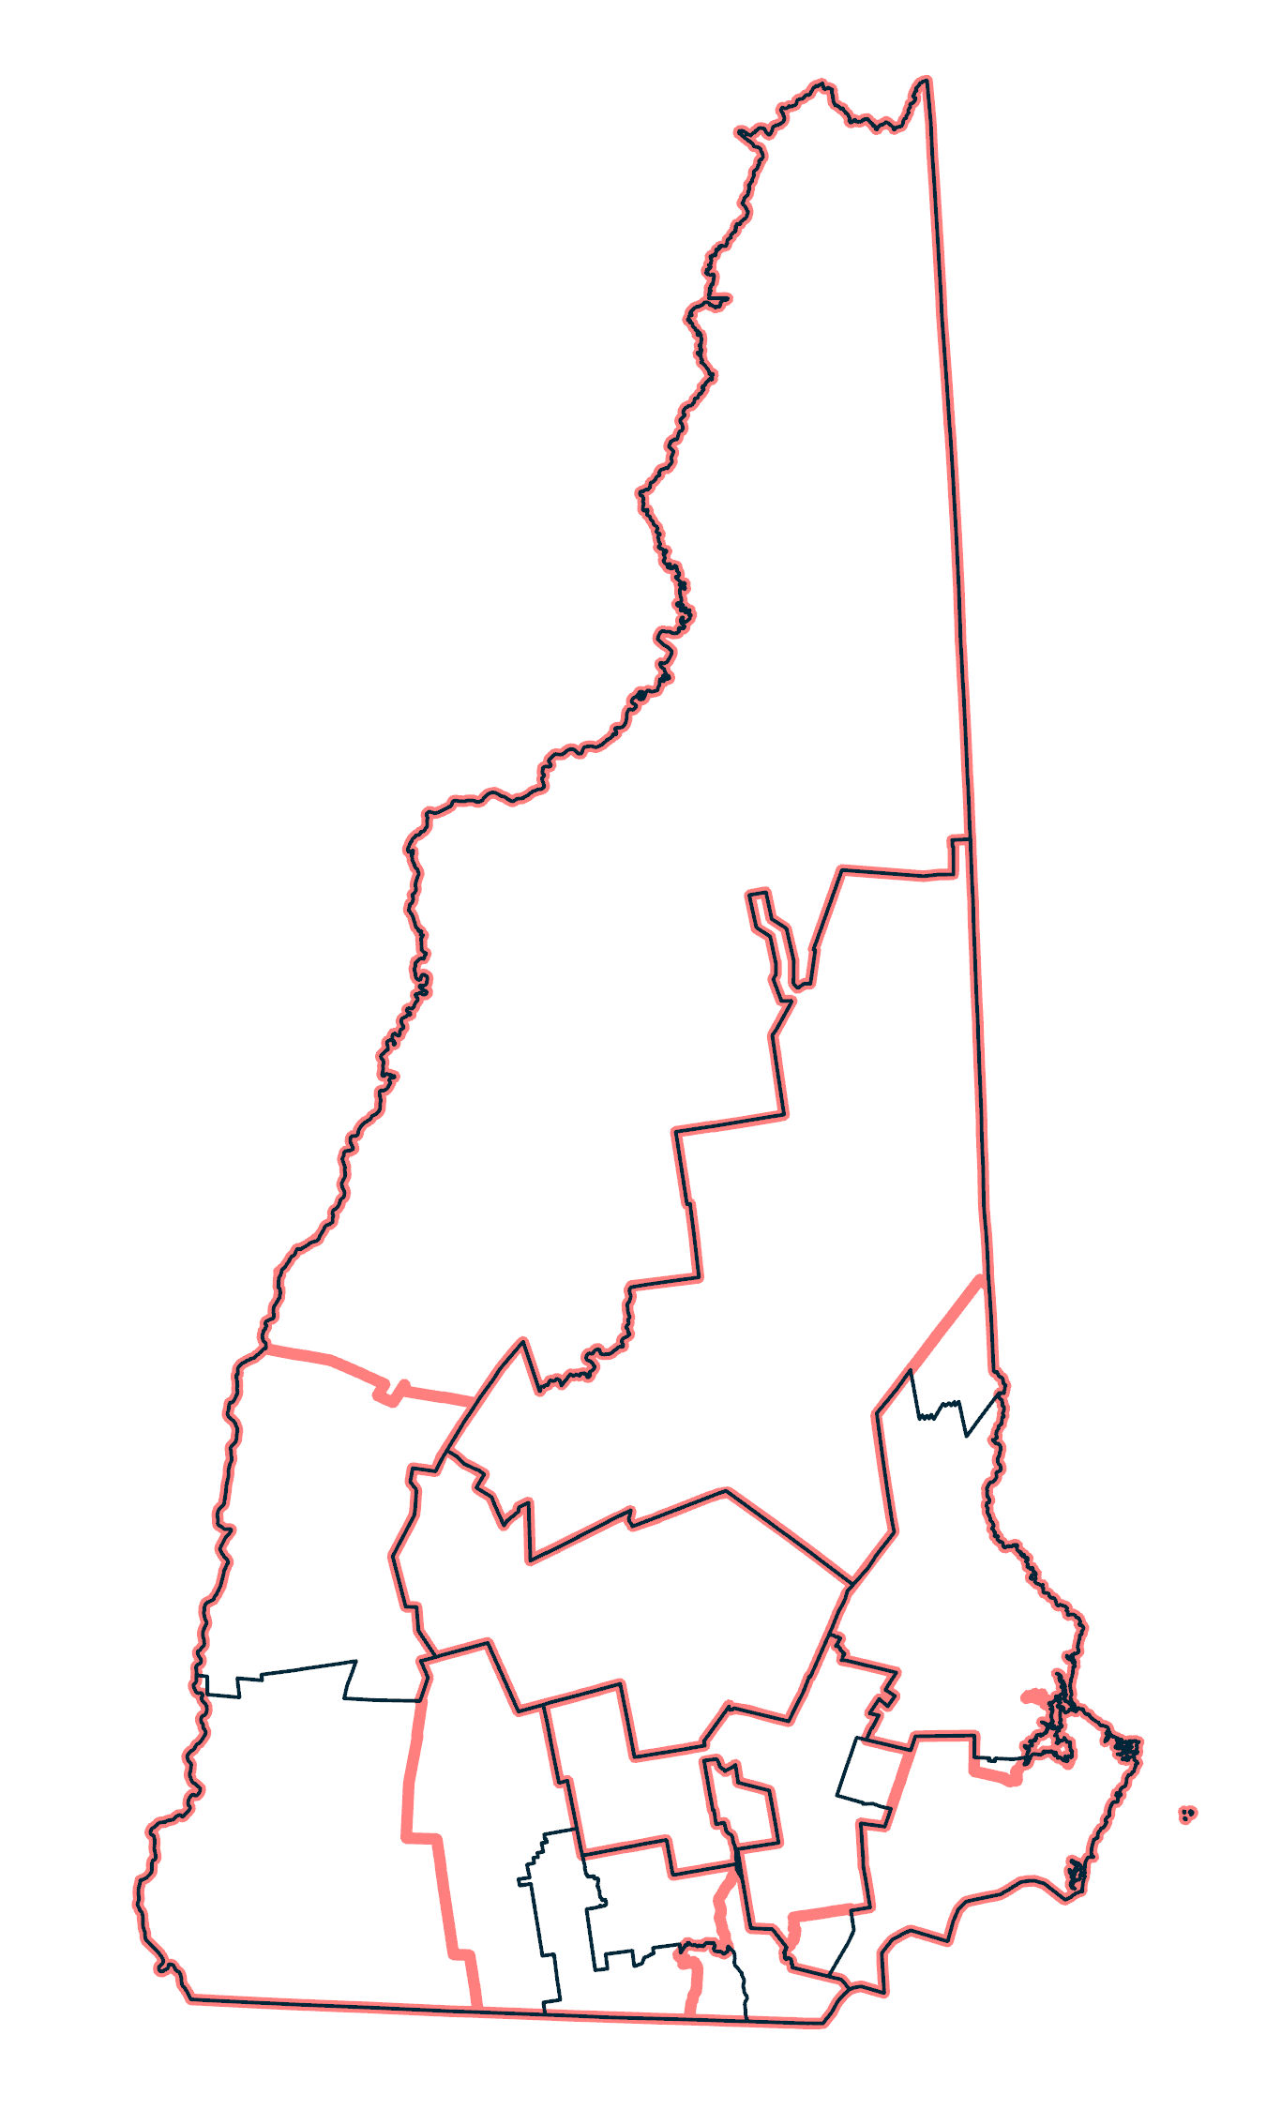
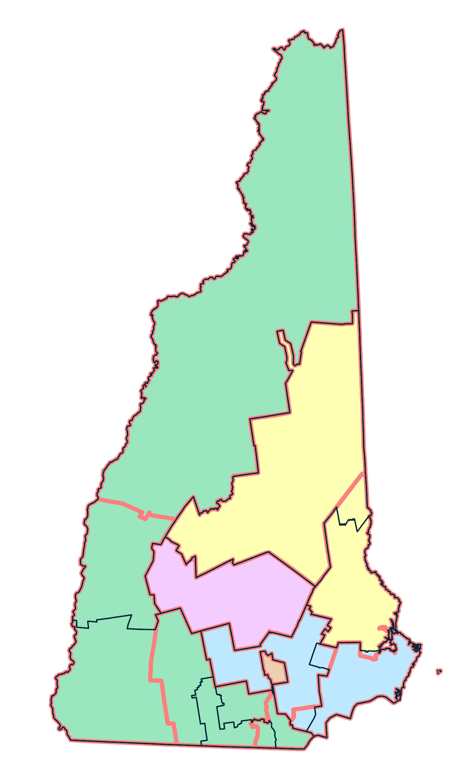
2010 PUMAs: 10
ConsPUMAs: 5
2020 PUMAs: 10
New Hampshire

Slide 59
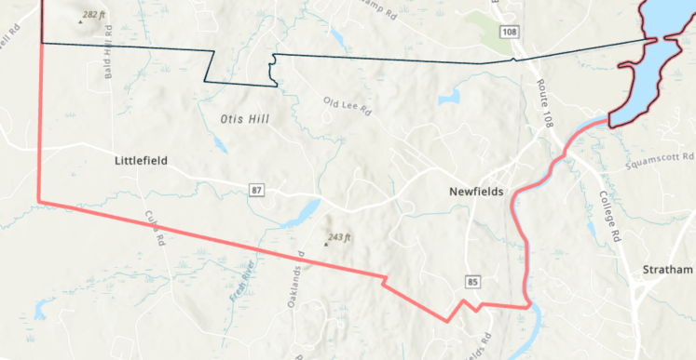
Esri Basemap 2025

Slide 60
Iterative Mismatch Reduction
IMR Applied to 2010 & 2020 PUMAs with 1% Mismatch Tolerance
 | Set each 2020 PUMA to be a ConsPUMA
 | Merge any set of ConsPUMAs where each has a majority of its population in the same 2010 PUMA
 | Pairs of ConsPUMAs that share population with a single 2010 PUMA, where at least one ConsPUMA’s mismatch ≥ 1% in 2010 or 2020
 | Average of the 2 ConsPUMAs’ prior mismatch scores minus the mismatch for the merged pair, using average of 2000 & 2010 populations
 | To shorten the process, apply a merger in each U.S. state all at once
 | Final output: Minimally acceptable consistency
Initialize
ConsPUMAs
Preliminary aggregation
Identify
merger candidates
Compute potential
mismatch declines
Merge pair that yields greatest decline
Repeat until every mismatch < 1%

Slide 61
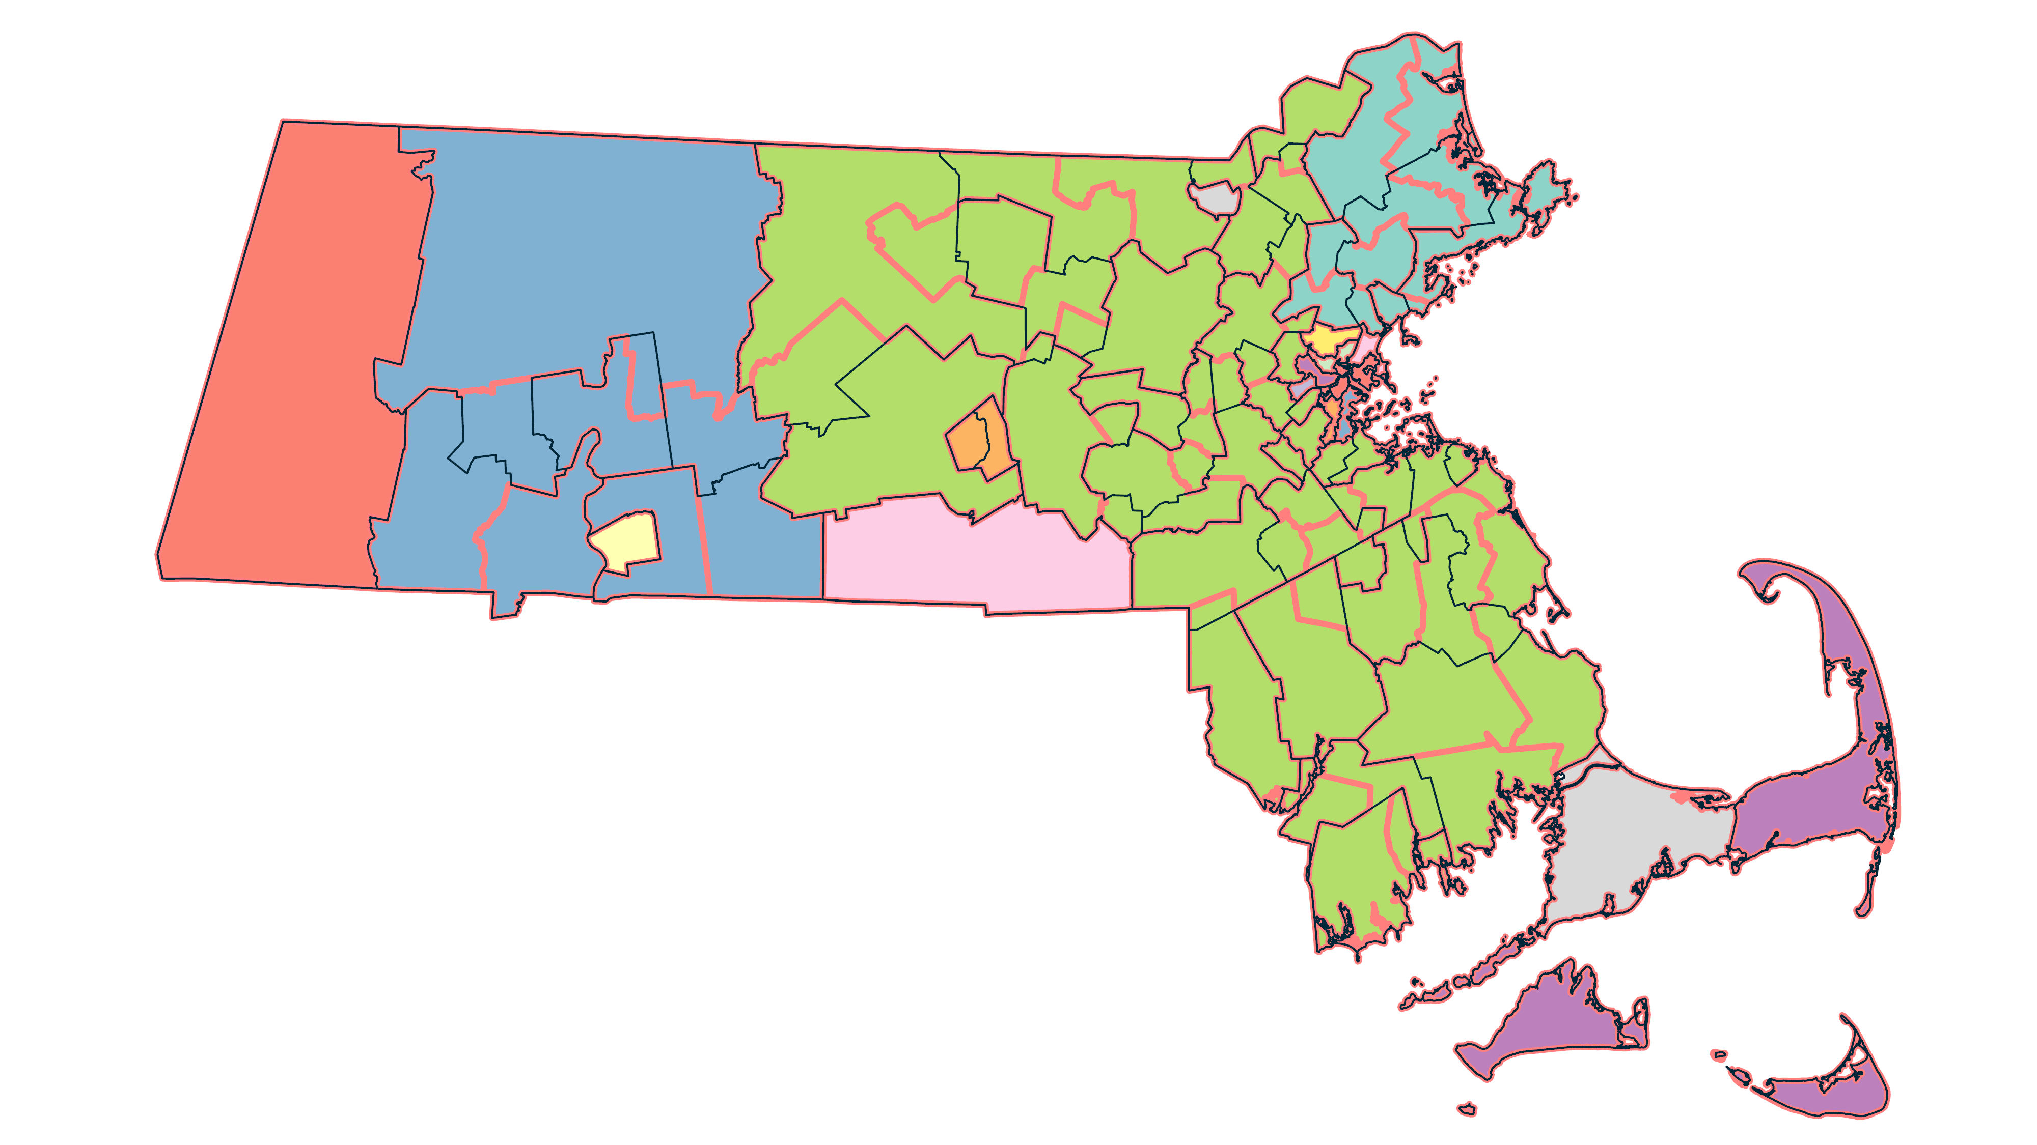
Massachusetts
2020 PUMAs: 28!
2010 PUMAs: 52
2020 PUMAs: 54
ConsPUMAs: 19

Slide 62
Population by ConsPUMA Size

Slide 63
Population by ConsPUMA Size

Slide 64
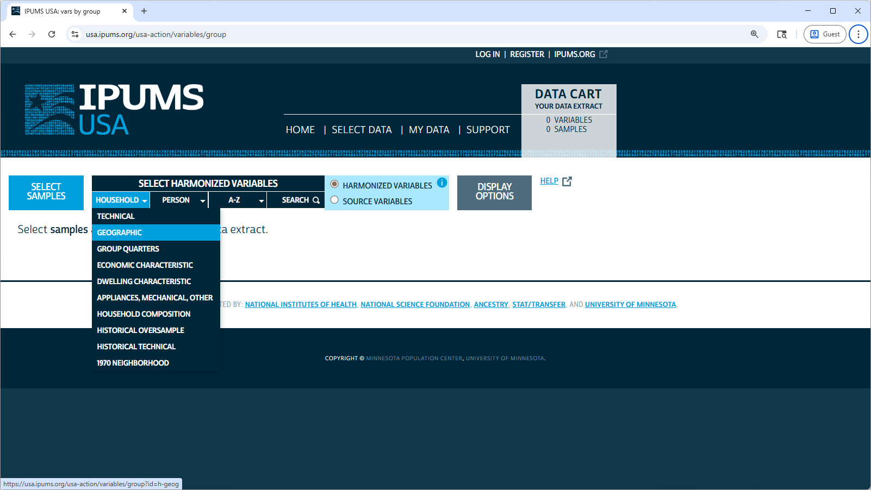

Slide 65
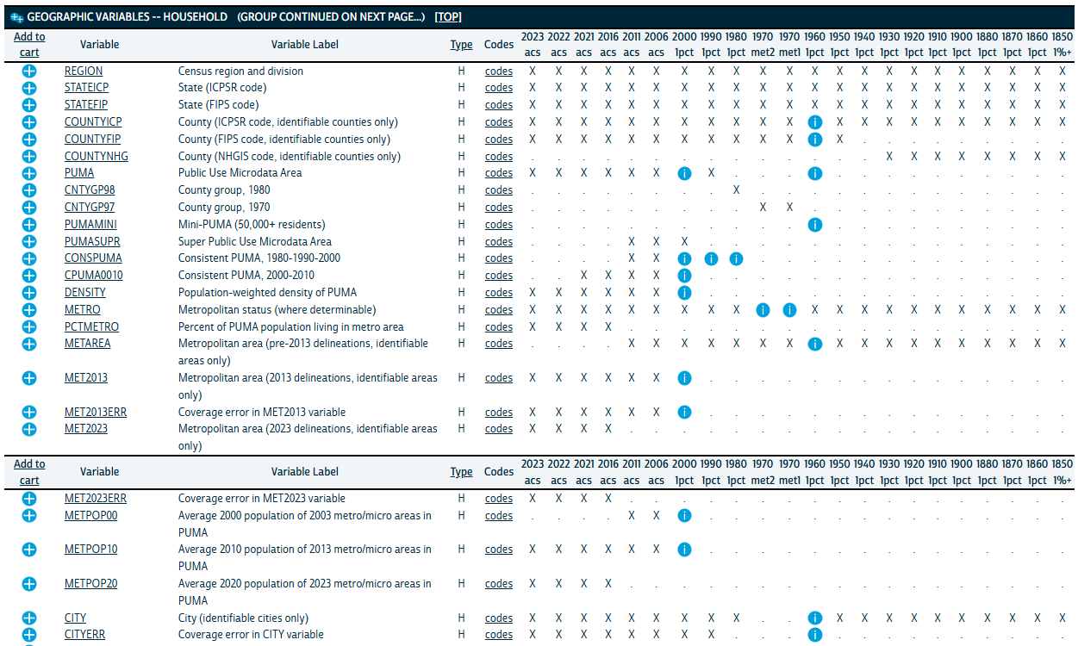

Slide 67
Migration & Place of Work

Slide 68
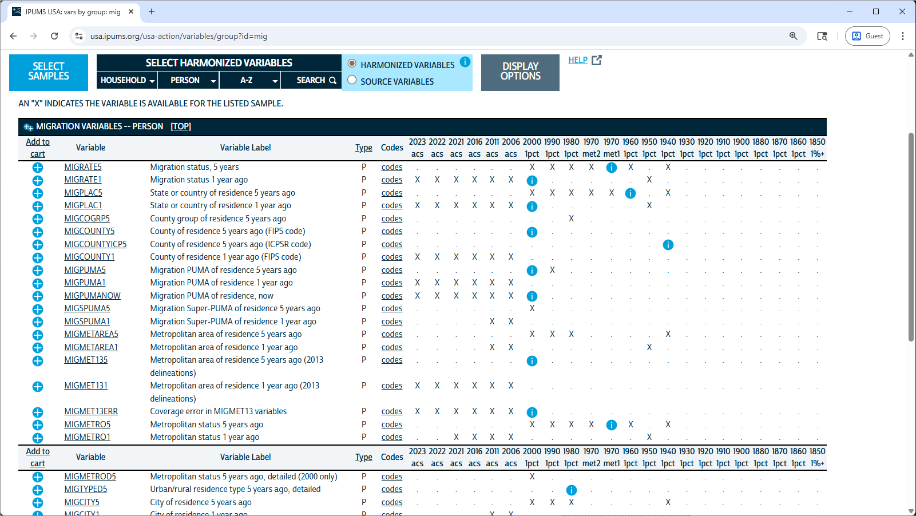

Slide 69
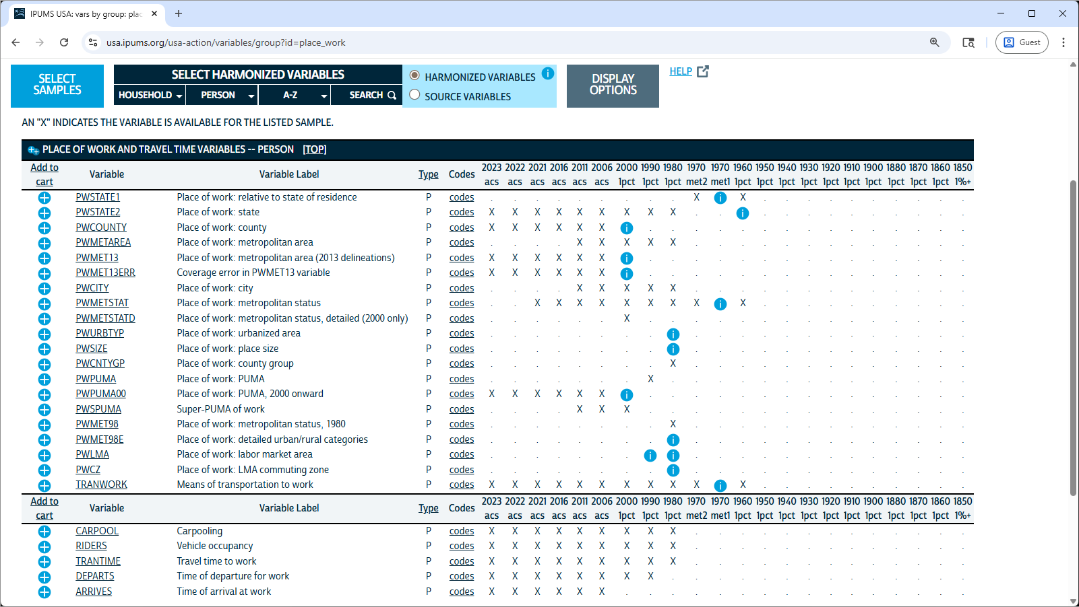

Slide 70
Other Resources

Slide 71
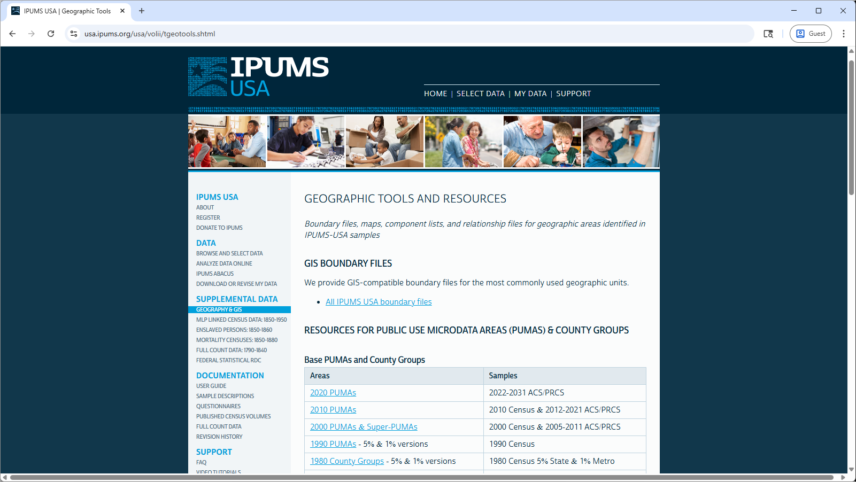

Slide 72
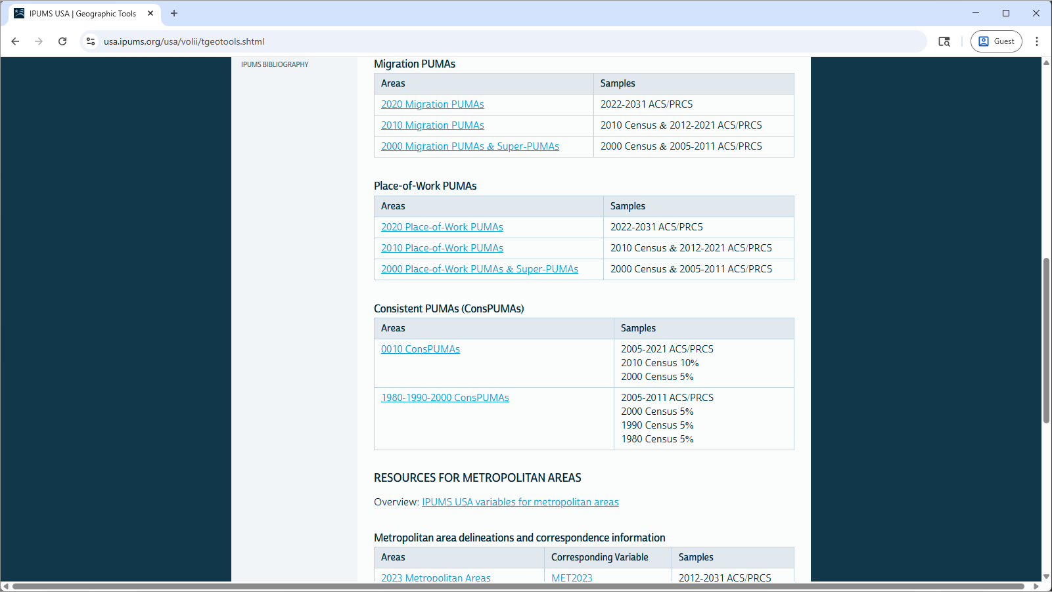

Slide 73
Acknowledgments
Eunice Kennedy Shriver National Institute of Child Health & Human Development
  IPUMS USA — R01HD043392
  Minnesota Population Center — P2CHD041023

Slide 74
Questions?
User forum
https://forum.ipums.org/
Email
ipums@umn.edu

Slide 75
Extra slides

Slide 76
HARMONIZATION

Slide 77
Example: NHIS Marital Status
Pre-2004 codes
1 = Married, spouse present
2 = Married, spouse absent
3 = Married, no spouse info
4 = Widowed
5 = Divorced
6 = Separated
7 = Never Married
2004-forward codes
1 = Separated
2 = Divorced
3 = Married
4 = Single/never married
5 = Widowed

Slide 78
Harmonized Marital Status Codes
10 = Married
11 = Married, spouse present
12 = Married, spouse absent
13 = Married, no spouse info
20 = Widowed
30= Divorced
40 = Separated
50 = Never Married
The first digit captures concepts that are consistent across all samples.
The second digit contains sample-specific detail

Slide 79
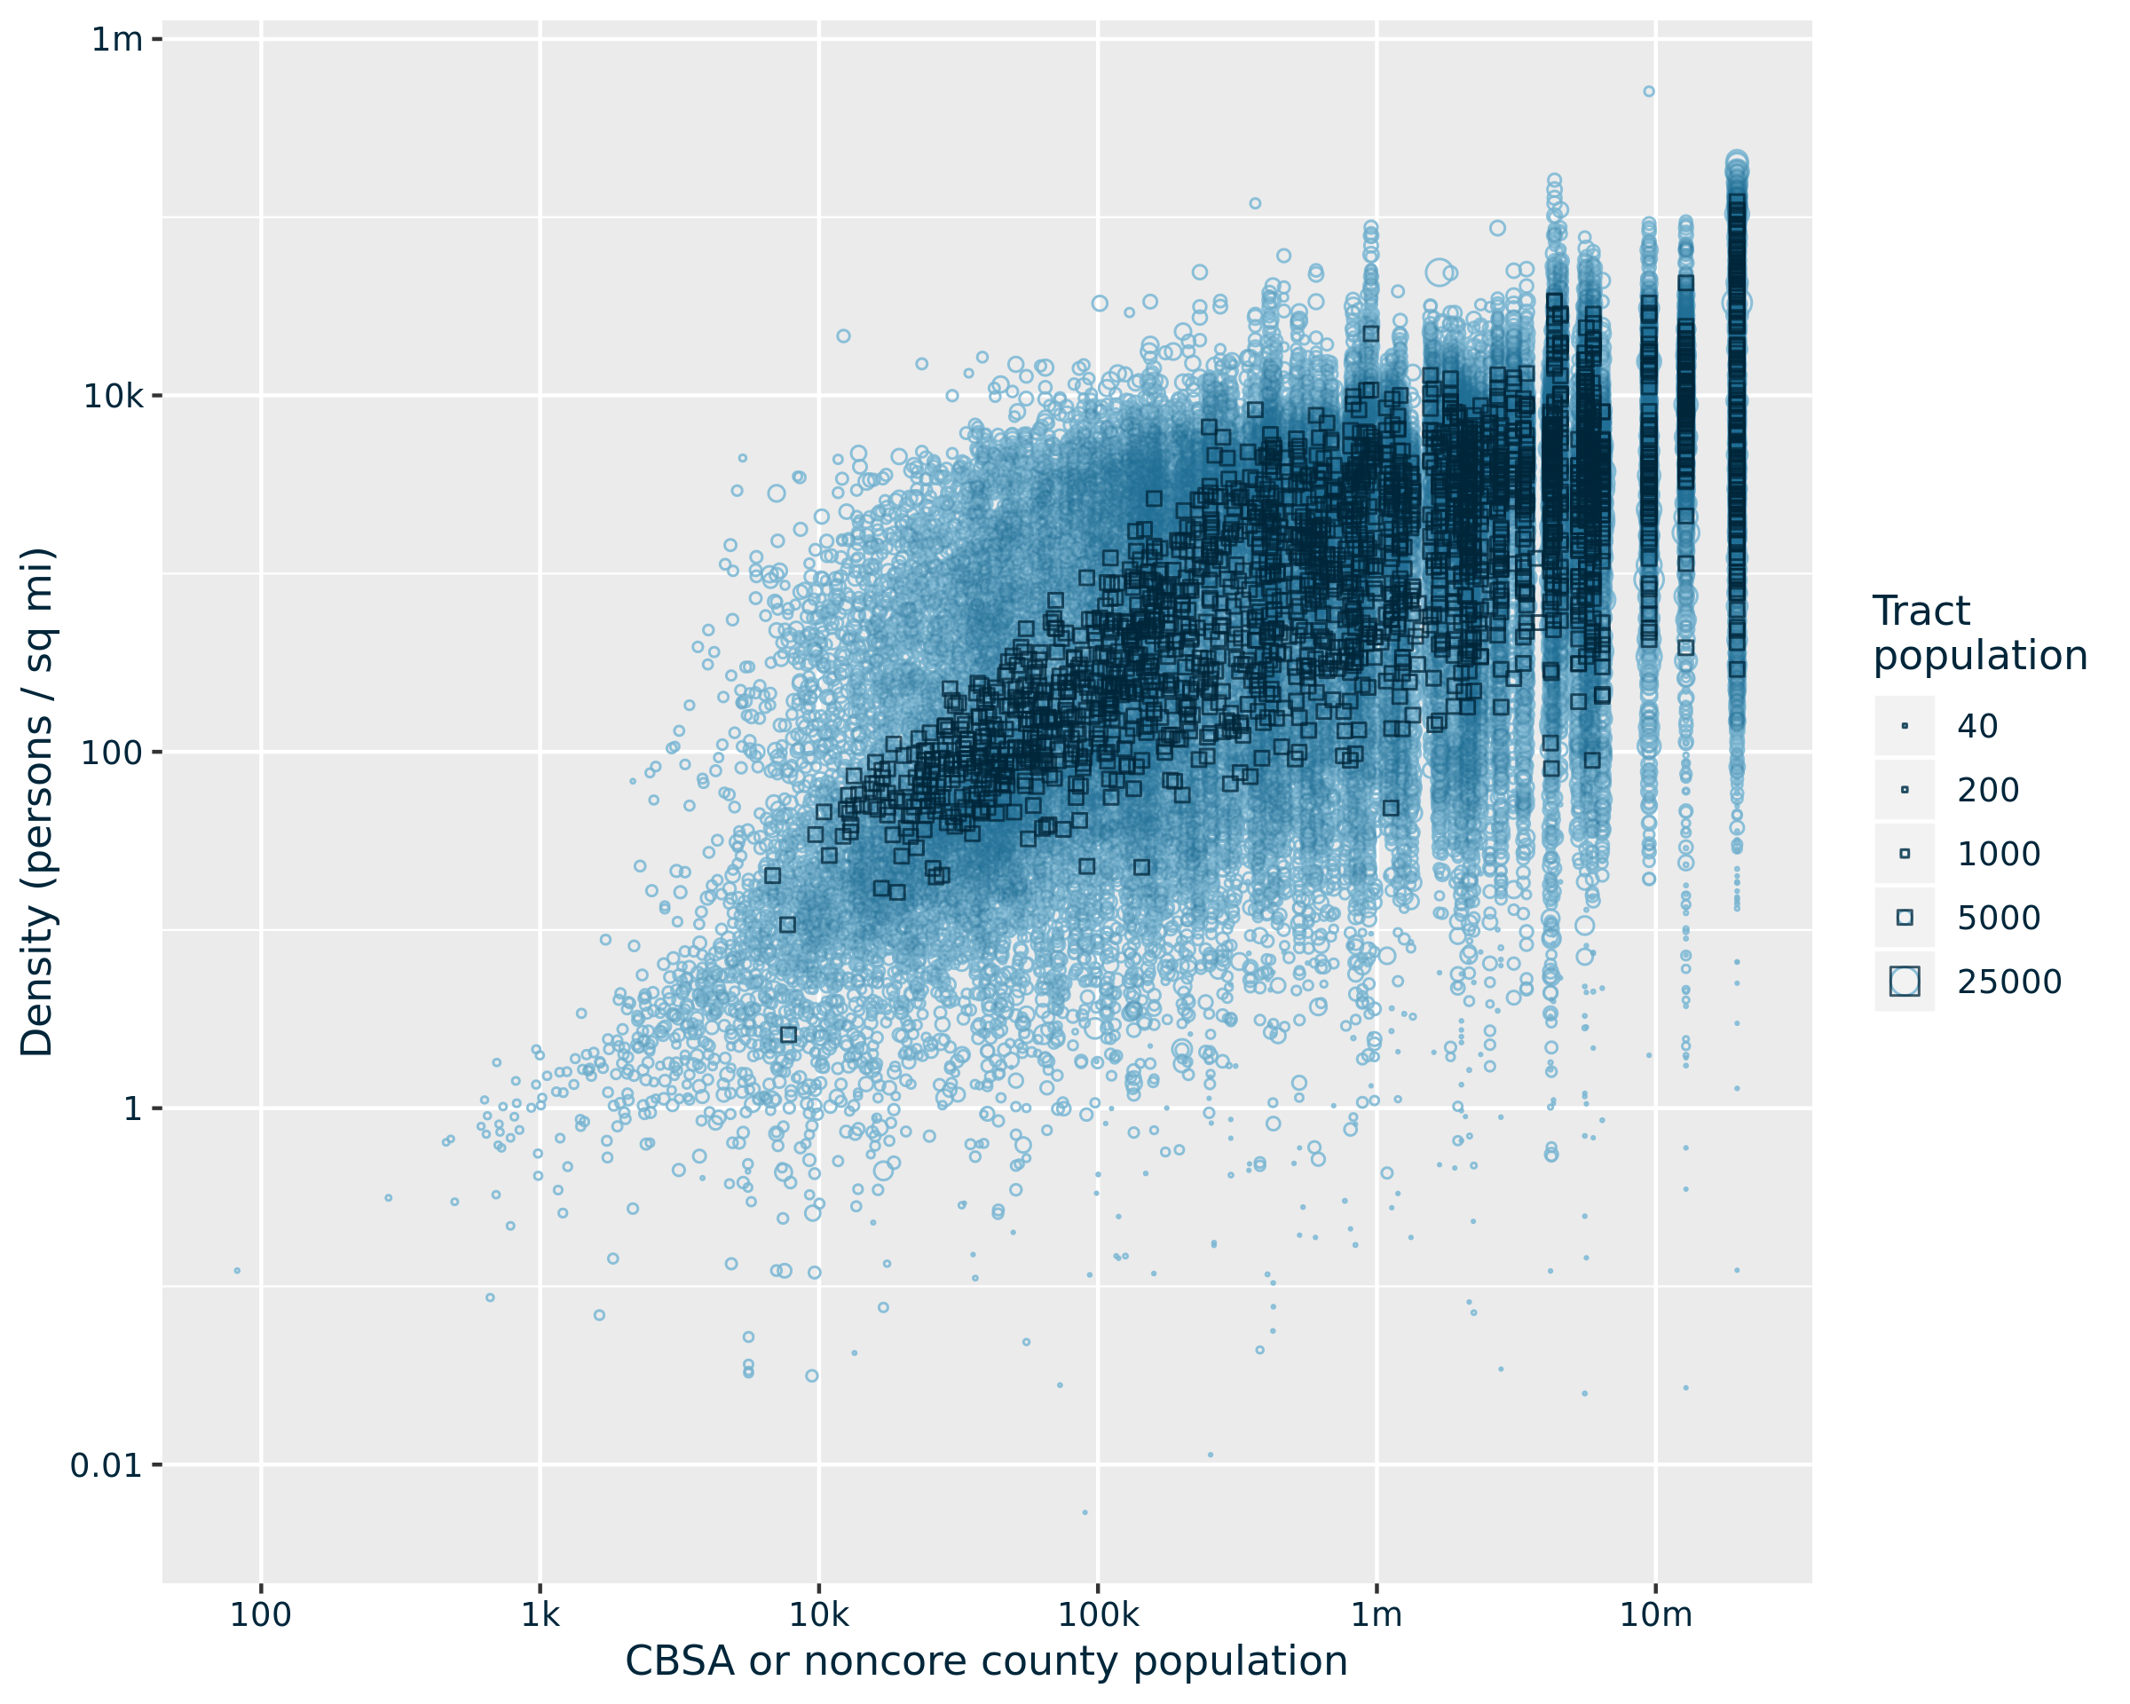
Limitations…
Tract
PUMA

