Slide 1

Linking Children, Adults, and Households in IPUMS MICS
April 15, 2026

Slide 2
Zoom Logistics
Webinar is being recorded and will be posted
Real-time closed captions are being auto-generated
  Turn on/off by clicking “CC” button in Zoom controls
Send questions about Zoom directly to host (IPUMS)
Submit content questions with Q&A tool
Will post written Q&A document (and any webinar specific files) following webinar

Slide 3

Anna Bolgrien
Project Manager of IPUMS MICS
IPUMS at University of Minnesota
Funded by NICHD and supported by UNICEF

Slide 4
What we are covering today
Units of analysis in IPUMS MICS
  An example household
Direct relationships between files/individuals in the household
Indirect relationships among individual household members
How to decide what relationships are needed for your research question?
Stata demonstration
Notes:
Additional resources: [link to user note on linking – Z link for presentation]?

Slide 5
What will not be covered today
Background about IPUMS MICS
Selecting unit of analysis (briefly on next slide)
Finding variables
Creating extracts
Downloading, opening and running extracts in Stata
Merging or linking in other statistical software
Notes:
See user notes for these steps – link in

Slide 6
A quick mention about language…
Unit of analysis, data files, data sets
Merging, linking
Key identifiers, unique IDs
Records, observations
Household records vs individual records
Notes:
All of these different words basically refer to the same thing.

Slide 7
Units of Analysis in IPUMS MICS
Unit of Analysis Key | Description of Unit of Analysis
HH | Household Characteristics
HL | Household Members (Household List)
WM | Women age 15-49
CH | Children age 0-4
FS | Children age 5-17
MN | Men age 15-49*

Slide 8
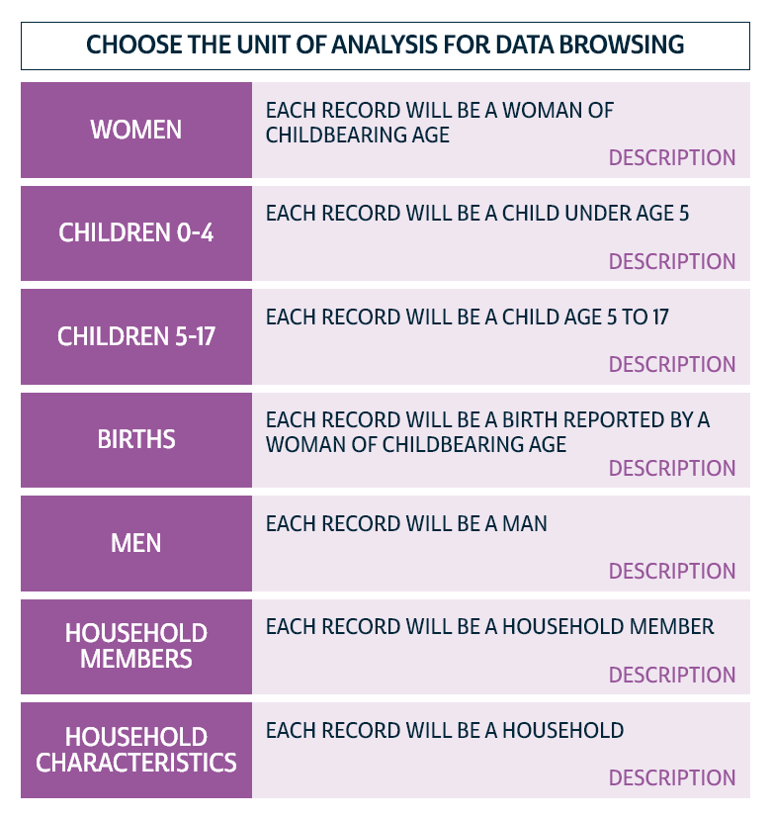


Selecting Data on the IPUMS MICS website
Select the Unit of Analysis
Select the Data
Change the Unit of Analysis

Slide 9
Why so many Units of Analysis?
Format in which UNICEF makes these data available
Due to our agreement with UNICEF, IPUMS provides unaltered data
Drawbacks
  Creating extracts from multiple units of analysis
  Potentially lots of files
  Complex relationships between files
Positives
  Complex relationships between files
Notes:
The complex relationships between the data files represent different types of relationships between the people in the households. So while this can be confusing, it is also a great strength of the project.
“IPUMS provides resources for harmonizing UNICEF MICS data and streamlining data management and cleaning. Providing guidance on linking across units of analysis is an extension of this work”

Slide 10
Within each sampled household (HH)
MICS sample design include
  Sample
  Clusters
  Households (typically 20 per cluster)
Unit of Analysis | Country | Sample | Cluster | HH Number
HH | Sierra Leone | Sierra Leone 2017 | 1 | 15
Notes:
This information about the sample, cluster, and household number is found on every single unit of analysis.
The HH unit specifically has information about the HH (water source, roof materials, ownership of livestock, etc).

Slide 11
Unique IDs for individuals within a household
Unit of Analysis | SAMPLE, CLUSTER, HHNO …
HH
HL | LINENO of the household list
WM | LINEWM
CH | LINECH
FS | LINECH
MN | LINEMN

Slide 12
Within the HH, there are household members (HL)
Unit of Analysis | HH members | Sex / Age | LINENO
HL | Head | M 40 | 1
HL | Spouse (of head) | F 30 | 2
HL | Daughter | F 16 | 3
HL | Daughter | F 10 | 4
HL | Son | M 8 | 5
HL | Daughter | F 4 | 6
HL | Grandson | M 1 | 7
HL | Mother (of head) | F 65 | 8
Notes:
Duplicate 4 times for each of the WM, CH, FS, MN units of analysis

Slide 13
Men (MN) age 15-49 within the household
Unit of Analysis | HH members | Sex / Age | Lineno
HL | Head | M 40 | 1
HL | Spouse (of head) | F 30 | 2
HL | Daughter | F 16 | 3
HL | Daughter | F 10 | 4
HL | Son | M 8 | 5
HL | Daughter | F 4 | 6
HL | Grandson | M 1 | 7
HL | Mother (of head) | F 65 | 8
Unit of analysis | Line number (LINEMN)
MN | 1
Notes:
Duplicate 4 times for each of the WM, CH, FS, MN units of analysis

Slide 14
Women (WM) age 15-49 within the household
Unit of Analysis | HH members | Sex / Age | Lineno
HL | Head | M 40 | 1
HL | Spouse (of head) | F 30 | 2
HL | Daughter | F 16 | 3
HL | Daughter | F 10 | 4
HL | Son | M 8 | 5
HL | Daughter | F 4 | 6
HL | Grandson | M 1 | 7
HL | Mother (of head) | F 65 | 8
Unit of analysis | Line number (LINEWM)
WM | 2
WM | 3
Notes:
Duplicate 4 times for each of the WM, CH, FS, MN units of analysis

Slide 15
Children age 0-4 (CH) within the household
Unit of Analysis | HH members | Sex / Age | Lineno
HL | Head | M 40 | 1
HL | Spouse (of head) | F 30 | 2
HL | Daughter | F 16 | 3
HL | Daughter | F 10 | 4
HL | Son | M 8 | 5
HL | Daughter | F 4 | 6
HL | Grandson | M 1 | 7
HL | Mother (of head) | F 65 | 8
Unit of analysis | Line number (LINENOCH)
CH | 6
CH | 7
Notes:
Duplicate 4 times for each of the WM, CH, FS, MN units of analysis

Slide 16
One child age 5-17 (FS) selected randomly
Unit of Analysis | HH members | Sex / Age | Lineno
HL | Head | M 40 | 1
HL | Spouse (of head) | F 30 | 2
HL | Daughter | F 16 | 3
HL | Daughter | F 10 | 4
HL | Son | M 8 | 5
HL | Daughter | F 4 | 6
HL | Grandson | M 1 | 7
HL | Mother (of head) | F 65 | 8
Unit of analysis | Line number (LINECH)
FS | 4
Notes:
Duplicate 4 times for each of the WM, CH, FS, MN units of analysis

Slide 17
7 different data files for this household
Unit of Analysis | Cluster | HH Number
HH | 1 | 15
Unit of Analysis | HH members | Sex / Age | LINENO
HL | Head | M 40 | 1
HL | Spouse (of head) | F 30 | 2
HL | Daughter | F 16 | 3
HL | Daughter | F 10 | 4
HL | Son | M 8 | 5
HL | Daughter | F 4 | 6
HL | Grandson | M 1 | 7
HL | Mother (of head) | F 65 | 8
Unit of analysis | Line number (LINEWM)
WM | 2
WM | 3
Unit of analysis | Line number (LINEMN)
MN | 1
Unit of analysis | Line number (LINECH)
CH | 6
CH | 7
Unit of analysis | Line number (LINECH)
FS | 4
Notes:
All samples have HH, HL, WM, and CH.
But only some have MN and only most recent have FS.
There are other UoA that are not discussed today (BH, FG).

Slide 18
What units of analysis do I need?
Selecting datasets depends on your research question
  Variables and topics
Relationships between datasets also depends on research question
Example: Breastfeeding
  Children who have been breastfed + mother’s characteristics
  Women who have breastfed + characteristics of their last child <5
  + average among children <5

Slide 19
Linking between data files
Direct file links
Indirect file links
Use a unique ID present in 2 data files
Household to individuals
Individuals to their household member record
Mother/caregiver to children
Require using a 3rd data file to accurately link 2 files
Biological mothers or fathers to children
Dataset 1
Dataset 2
Dataset 3
Dataset 1
Dataset 2
Notes:
Possible but tricky
Spouses (no identifier)
Siblings
Grandparents
Children when info is found on HH instead of child or HL.

Slide 20
HH onto the members (HL) using the CLUSTER and HHNO
Unit of Analysis | Cluster | HHNO
HH | 1 | 15
Unit of analysis | HH members | Sex / Age | Lineno | Linked Unit of analysis | Cluster | HHNO
HL | Head | M 40 | 1 | HH | 1 | 15
HL | Spouse (of head) | F 30 | 2 | HH | 1 | 15
HL | Daughter | F 16 | 3 | HH | 1 | 15
HL | Daughter | F 10 | 4 | HH | 1 | 15
HL | Son | M 8 | 5 | HH | 1 | 15
HL | Daughter | F 4 | 6 | HH | 1 | 15
HL | Grandson | M 1 | 7 | HH | 1 | 15
HL | Mother (of head) | F 65 | 8 | HH | 1 | 15
Notes:
Using the sample, cluster,
All individuals will have the same information about the HH. It will be duplicated across all members

Slide 21
HH onto individuals using the CLUSTER and HHNO
Unit of analysis | Line number (LINEWM) | Unit of Analysis
WM | 2 | HH
WM | 3 | HH
Unit of analysis | Line number (LINEMN) | Unit of Analysis
MN | 1 | HH
Unit of analysis | Line number (LINECH) | Unit of Analysis
FS | 4 | HH
Unit of analysis | Line number (LINECH) | Unit of Analysis
CH | 6 | HH
CH | 7 | HH

Slide 22
Individual units onto the members (HL)
Unit of analysis | HH members | Sex / Age | Lineno | Linked Unit of analysis
HL | Head | M 40 | 1 | MN
HL | Spouse (of head) | F 30 | 2 | WM
HL | Daughter | F 16 | 3 | WM
HL | Daughter | F 10 | 4 | FS
HL | Son | M 8 | 5
HL | Daughter | F 4 | 6 | CH
HL | Grandson | M 1 | 7 | CH
HL | Mother (of head) | F 65 | 8
Notes:
Using the sample, cluster,
All individuals will have the same information about the HH. It will be duplicated across all members
Notice that the 8 year old boy and grandmother don’t have any files that can be linked to them.

Slide 23
HL onto individuals using CLUSTER, HHNO, LINENO
Unit of analysis | Line number (LINEWM) | Linked Unit of Analysis
WM | 2 | HL
WM | 3 | HL
Unit of analysis | Line number (LINEMN) | Linked Unit of Analysis
MN | 1 | HL
Unit of analysis | Line number (LINECH) | Linked Unit of Analysis
FS | 4 | HL
Unit of analysis | Line number (LINECH) | Linked Unit of Analysis
CH | 6 | HL
CH | 7 | HL

Slide 24
What about mother’s information onto children?
Not just biological children of women
MICS samples all children age 0-4 in household
All children assigned a “mother/caregiver” (MC) proxy respondent

Slide 25
Children link to a WM record of the Mother/Caregiver using LINEMC
Unit of analysis | Line number (LINECH) | Mother/caregiver (LINEMC)
CH | 6 | 2
CH | 7 | 3
Unit of analysis | Line number (LINEWM)
WM | 2
WM | 3
Notes:
If the line number in the WM file matches to the Line of the MC, then this women can be linked to these children.

Slide 26
What if the mother/caregiver isn’t the biological mothers?
If the child’s mother lives in the household,
  she is the “mother/caregiver”
  She will have a WM record, if she is between 15-49
  She will not have a WM record, if older than 49
If the child’s mother does not live in the household,
  A caregiver is a member of the household (HL)
  The caregiver maybe can be linked to a WM record (LINEMC)
    Aunt, step-mother, sister age 15-49
  Or caregiver may be male
    Father, brother

Slide 27
Household Members age 0-17 have identifiers for biological mothers and fathers
Unit of Analysis | HH members | Sex / Age | LINENO | Bio Mother | Bio Father
HL | Head | M 40 | 1 | - | -
HL | Spouse (of head) | F 30 | 2 | - | -
HL | Daughter | F 16 | 3 | NA | 1
HL | Daughter | F 10 | 4 | NA | 1
HL | Son | M 8 | 5 | 2 | 1
HL | Daughter | F 4 | 6 | 2 | 1
HL | Grandson | M 1 | 7 | 3 | NA
HL | Mother (of head) | F 65 | 8
Notes:
All samples have HH, HL, WM, and CH.
But only some have MN and only most recent have FS.
There are other UoA that are not discussed today (BH, FG).

Slide 28
The daughter in line 6 can be linked to the WM in line 2
Unit of Analysis | HH members | Sex / Age | LINENO | Bio Mother | Bio Father
HL | Head | M 40 | 1 | - | -
HL | Spouse (of head) | F 30 | 2 | - | -
HL | Daughter | F 16 | 3 | NA | 1
HL | Daughter | F 10 | 4 | NA | 1
HL | Son | M 8 | 5 | 2 | 1
HL | Daughter | F 4 | 6 | 2 | 1
HL | Grandson | M 1 | 7 | 3 | NA
HL | Mother (of head) | F 65 | 8
Unit of analysis | Line number (LINECH) | Mother/caregiver (LINEMC)
CH | 6 | 2
CH | 7 | 3
Unit of analysis | Line number (LINEWM)
WM | 2
WM | 3
Notes:
All samples have HH, HL, WM, and CH.
But only some have MN and only most recent have FS.
There are other UoA that are not discussed today (BH, FG).

Slide 29
The grandson in line 7 can be linked to the WM in line 3
Unit of Analysis | HH members | Sex / Age | LINENO | Bio Mother | Bio Father
HL | Head | M 40 | 1 | - | -
HL | Spouse (of head) | F 30 | 2 | - | -
HL | Daughter | F 16 | 3 | NA | 1
HL | Daughter | F 10 | 4 | NA | 1
HL | Son | M 8 | 5 | 2 | 1
HL | Daughter | F 4 | 6 | 2 | 1
HL | Grandson | M 1 | 7 | 3 | NA
HL | Mother (of head) | F 65 | 8
Unit of analysis | Line number (LINECH) | Mother/caregiver (LINEMC)
CH | 6 | 2
CH | 7 | 3
Unit of analysis | Line number (LINEWM)
WM | 2
WM | 3
Notes:
All samples have HH, HL, WM, and CH.
But only some have MN and only most recent have FS.
There are other UoA that are not discussed today (BH, FG).

Slide 30
The FS child’s caregiver is not her mother
Unit of Analysis | HH members | Sex / Age | LINENO | Bio Mother | Bio Father
HL | Head | M 40 | 1 | - | -
HL | Spouse (of head) | F 30 | 2 | - | -
HL | Daughter | F 16 | 3 | NA | 1
HL | Daughter | F 10 | 4 | NA | 1
HL | Son | M 8 | 5 | 2 | 1
HL | Daughter | F 4 | 6 | 2 | 1
HL | Grandson | M 1 | 7 | 3 | NA
HL | Mother (of head) | F 65 | 8
Unit of analysis | Line number (LINECH) | Mother/ caregiver (LINEMC)
FS | 4 | 2
The caregiver (the spouse of the head) is likely the step-mother of this 10-year-old.
Unit of analysis | Line number (LINEWM)
WM | 2
WM | 3
Notes:
All samples have HH, HL, WM, and CH.
But only some have MN and only most recent have FS.
There are other UoA that are not discussed today (BH, FG).

Slide 31
Can also link biological fathers to MN dataset
Unit of Analysis | HH members | Sex / Age | LINENO | Bio Mother | Bio Father
HL | Head | M 40 | 1 | - | -
HL | Spouse (of head) | F 30 | 2 | - | -
HL | Daughter | F 16 | 3 | NA | 1
HL | Daughter | F 10 | 4 | NA | 1
HL | Son | M 8 | 5 | 2 | 1
HL | Daughter | F 4 | 6 | 2 | 1
HL | Grandson | M 1 | 7 | 3 | NA
HL | Mother (of head) | F 65 | 8
Unit of analysis | Line number (LINEMN)
MN | 1
Notes:
All samples have HH, HL, WM, and CH.
But only some have MN and only most recent have FS.
There are other UoA that are not discussed today (BH, FG).

Slide 32
What relationship do I want to link?
Depends on the research question
  What is the end dataset?
  On which dataset do you link?
  Do you have 1 or many relationships?
Direct relationships are usually 1:1 or many:1
  A WM links to the same individual on household roster (1 WM: 1HL)
  All individuals within a single HH (many HL: 1 HH)
1:many relationships require more decisions
  Multiple children for a woman (1 WM : many CH)
    Youngest child, oldest child, summary of children, wide format
Notes:
What I showed only one half of the variations.
Where do you do the data manipulation? Some vars have same name in multiple files.
The many onto 1 is going to be tricker than what I was showing.
It doesn’t really make sense UNLESS YOUR RESEARCH QUESTION IS VERY SPECIFIC
Age of oldest or youngest child

Slide 33
Stata defined merge relationships
“master" | “Using”
 | HH | HL | WM | MN | CH | FS | BH
HH |  | x | x | x | x | x | x
HL | m:1 |  | 1:1 | 1:1 | 1:1 | 1:1 | 1:1
WM | m:1 | 1:1 |  |  | x | x | x
MN | m:1 | 1:1
CH | m:1 | 1:1 | m:1
FS | m:1 | 1:1 | m:1
BH | m:1 | 1:1 | m:1

Slide 34

Any questions?
Switching to Stata
Will post written Q&A document, recording, slides, and do files following webinar
Future questions to ipums@umn.edu

