Slide 1
All Graduate Student Meeting: What the
MPC can do for you
January 29, 2021

Slide 2
Cast of Characters
Rob Warren, MPC Director and Pop Health Training Co-Director
Ann Meier, MPC Training Director
Theresa Osypuk, MPC Associate Director and
Pop Health Training Co-Director
Rachel Magennis, Pop Studies Training Coordinator
Lindsey Fabian, Training Manager

Slide 3
Welcome!
What is the MPC?
Introduction of Ann Meier, MPC Training Director

Slide 4
Benefits of MPC Student Membership
Seminars
Workshops
Writing support services
Student research funding
Conference/Travel funds
Poster Design and Printing Support
Data Enclave and Data Use Contracts
Webpage

Slide 5
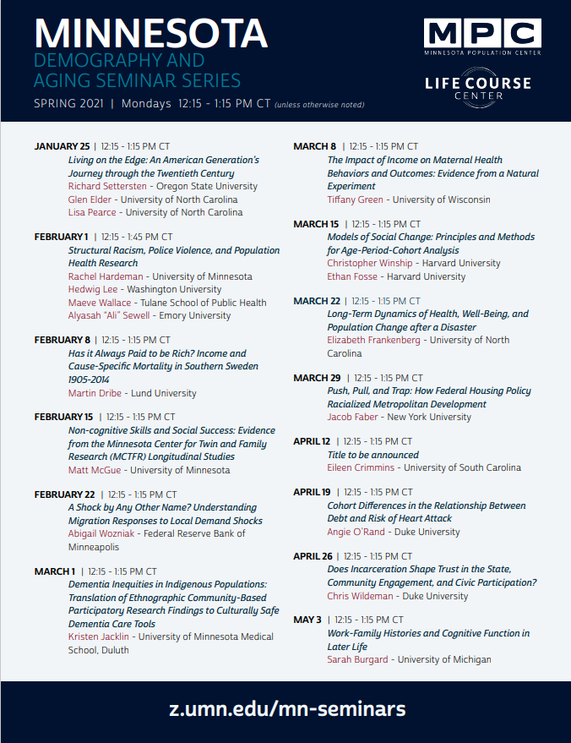
Minnesota Demography and Aging Seminar Series

Slide 6
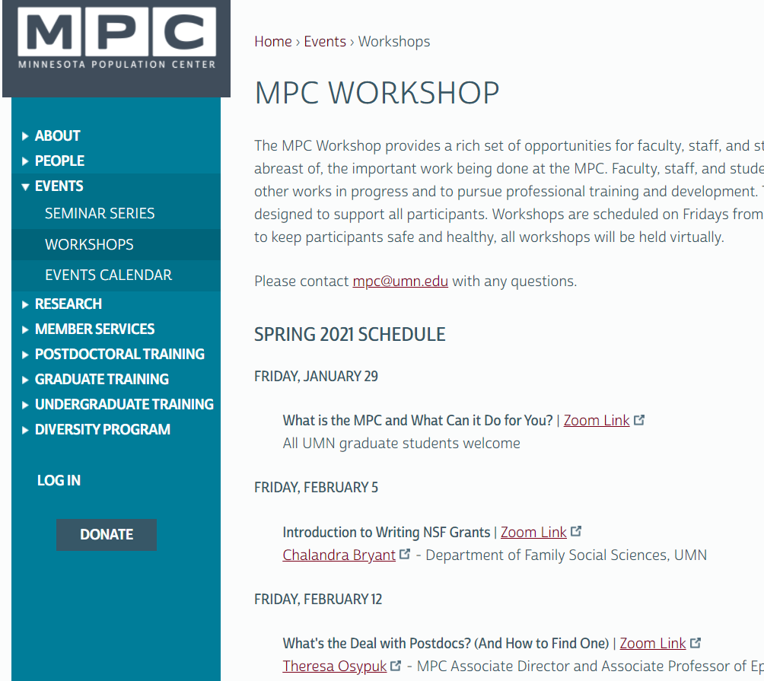
Friday Workshops

Slide 7
Trivia!
1. Who is the current president of the University of Minnesota?
Kaler
Gabel
Cramer
Biden

Slide 8
Benefits of Student Membership
Seminars
Workshops
Writing support services
NEW: Student research grants
Conference/Travel funds
Poster Design and Printing Support
Data enclave

Slide 9
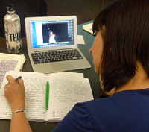
Writing Support Services
&
Writing Hunker
Wednesday & Friday
8:00am to noon
Paper Hatchling
Some Fridays
12:15-1:15pm

Slide 10
Writing Support Services
Grant Development and Submission Support:
NIH F31s and UMN IDFs
Notes:
NIH F31s - 2-3 years NIH funding for graduate student population scholars from under-represented groups.
Interdisciplinary Doctoral Fellowships

Slide 11
Trivia!
2. In what year did Minnesota become a state?
1858
1843
1901
1789

Slide 12
Benefits of Student Membership
Seminars
Workshops
Writing support services
Student research funding
Travel funds (PAA travel funds)
Poster Design and Printing Support
Data enclave

Slide 13
Student research funding
Up to $2,000 to help graduate students access the resources they need to develop, conduct or complete a research project.
Travel
Data or software
Hire field researchers
Pay participants
Hire translator or transcriber
Deadlines: October and February
Notes:
*** Feb deadline is extended to Feb 26th More details on website under Member Services.

Slide 14
Trivia!
3. What is the Minnesota state bird?
Bald Eagle
Wild Turkey
Loon
Robin

Slide 15
Benefits of Student Membership
Seminars
Workshops
Writing support services
NEW: Student research grants
Conference/Travel funds
Poster Design and Printing Support
Data enclave

Slide 16
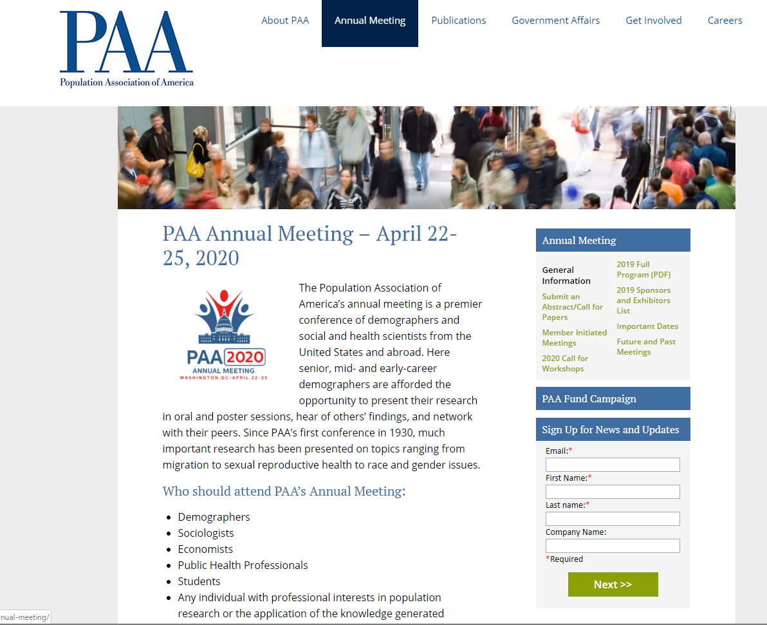
Conference/Travel Funding
Assistance with cost of attending PAA and other conferences

Slide 17
Trivia!
4. What is the Minnesota state fish?
Walleye
Northern Pike
Smallmouth Bass
Catfish

Slide 18
Benefits of Student Membership
Seminars
Workshops
Writing support services
NEW: Student research grants
Conference/Travel funds
Poster Design and Printing Support
Data enclave

Slide 19
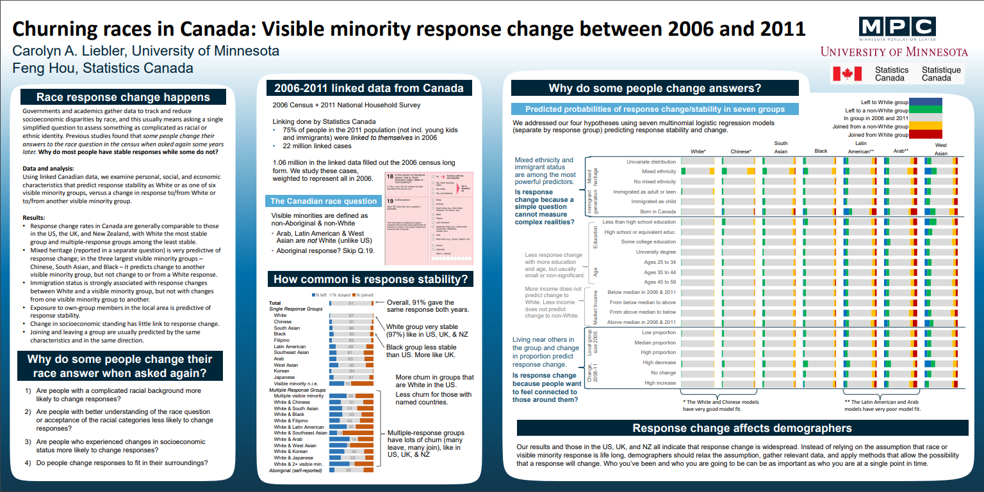
Poster Design and Printing Support
Insert poster examples

Slide 20
Trivia!
5. How many lakes does Minnesota really have?
9,233
15,291
12,802
22,905

Slide 21
Benefits of Student Membership
Seminars
Workshops
Writing support services
NEW: Student research grants
Travel funds (PAA travel funds)
Poster Design and Printing Support
Data Enclave and Data Use Contracts
Webpage

Slide 22
Data Enclave and Data Use Contracts
Many data sources require that you only use their data in a secure physical data enclave.
We have enclaves that student members can access.
Some data sources allow you to use data via a secure server from your own computer. We can help you fill out those applications.
Some data sources that require the use of an enclave:
National Center for Education Statistics
Eurostat
Bureau of Labor Statistics
National Longitudinal Surveys of Youth
National Death Index

Slide 23
Trivia!
6. Which of Minnesota’s 67 state parks is the most visited?
Father Hennepin
William O’Brien
Gooseberry Falls
D. Fort Snelling

Slide 24
Benefits of Student Membership
Seminars
Workshops
Writing support services
NEW: Student research grants
Travel funds (PAA travel funds)
Poster Design and Printing Support
Data enclave
Webpage

Slide 25
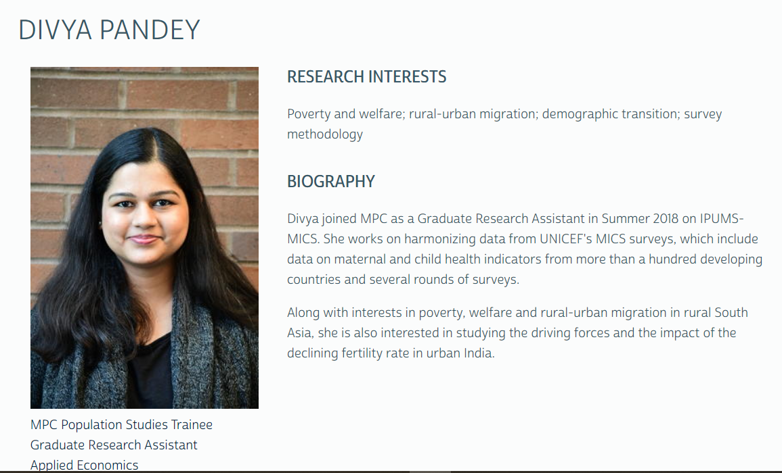
Graduate Student Webpages

Slide 26
Trivia!
7. How many counties does Minnesota have?
102
43
87
No one knows

Slide 27
Opportunities and Resources
Advisory Board (3 student members)
Diversity Fellowship Program
Training Programs
Population Studies
Population Health
Lots of Free Data!

Slide 28
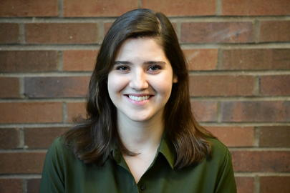
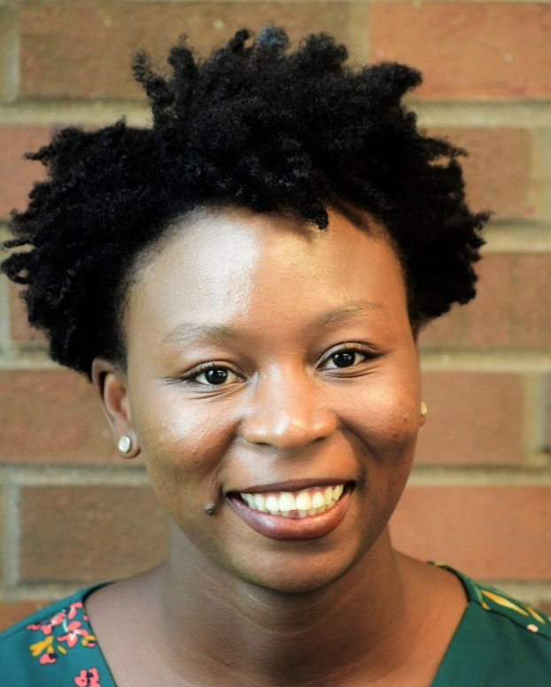
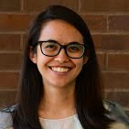
MPC Advisory Board Student Members
Notes:
Anna Bokun, J’Mag Karbeah,Naomi Thyden

Slide 29
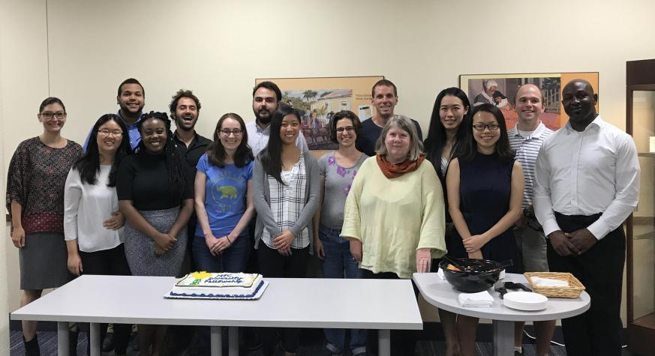
Summer Diversity Fellowship Program

Slide 30
Trivia!
8. What is the Minnesota state flower?
Goldenrod
Aster
Lady Slipper
Wild Rose

Slide 31
Training in Population Studies
Population Studies Training Program
Population Health Training Program
Graduate Population Studies Minor (Master’s and PhD)
Population Studies Courses

Slide 32
Trivia!
9. Who is the current mayor of St. Paul?
Jacob Frey
Mark Dayton
Ryan Suter
Melvin Carter

Slide 33
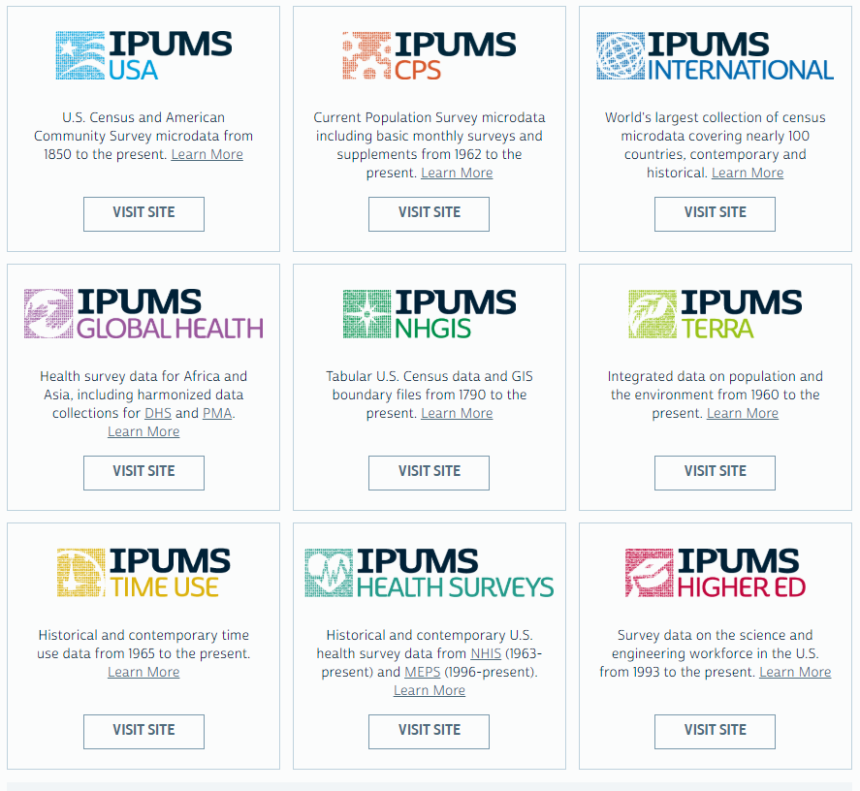
Free Data!
We have an extraordinary amount of demographic, spatial and health data

Slide 34
Research Assistant Opportunities
Student members hear first about new research positions.
Almost 50 grad RAs on data projects last year.

Slide 35
Trivia!
10. What state currently has the highest response rate from the 2020 census (~75%)?
Puerto Rico
Maine
Illinois
Minnesota

Slide 36
How to Become a Member
Email a brief (2-3 sentence) description of your population related research interests.
Attach a current CV or resume.
Email mpc@umn.edu
The Advisory Board reviews and approves membership applications at their monthly meetings.

Slide 37
Life Course Center
The LCC is a University-wide center for the study of aging and the life course.
Life course studies encompass all stages of life from birth to death.
If interested in becoming a student member email lifecourse@umn.edu
Notes:
Although the center is not currently a degree-granting program, it enhances graduate education through research, seminars, and courses offered by center faculty. Graduate students participate as research assistants and as collaborators in faculty research. Students and faculty alike share their research ideas, plans, and findings in the Work, Family, and Time Workshops.

Slide 38
Questions?
Contact Us!
mpctrain@umn.edu

Slide 39
Trivia answers!
Name of new UMN president: Joan Gabel
Year Minnesota became a state: 1858
State bird: Loon
State fish: Walleye
How many lakes does Minnesota really have: 15,291
Which of Minnesota's 67 state parks is the most visited: Fort Snelling
How many counties in MN: 87
State flower: Lady Slipper
Current mayor of St. Paul: Melvin Carter
What state currently has the highest response rate from the 2020 census (~75%)?: Minnesota!

